Slide 1
Welcome to Year 1
Chloe Price, Georgia Green, Sahira Mohammad, Jo Dirrane

Slide 2
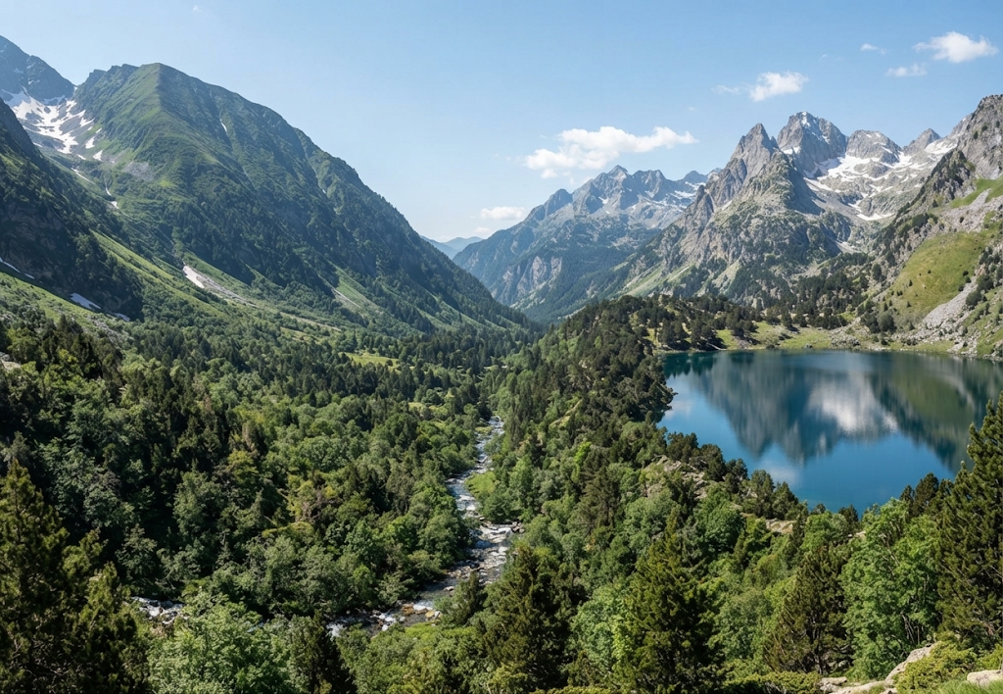
Pyrenees Class

Slide 3

green Class

Slide 4

Maths
Maths – White Rose mastering number

Slide 5
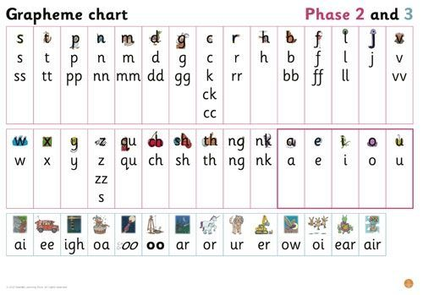
Phonics

Slide 6


English
Phonics
Reading at home
Guided reading

Slide 7
Science
Animals (including humans)
Materials
Plants
Seasonal Change

Slide 8
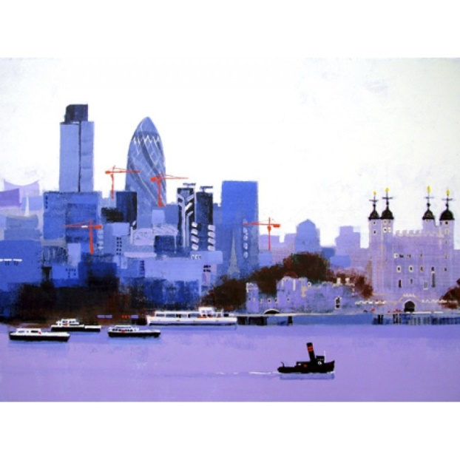
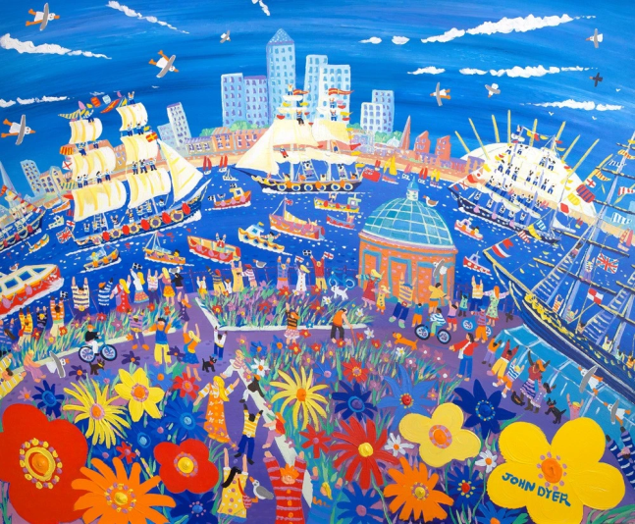
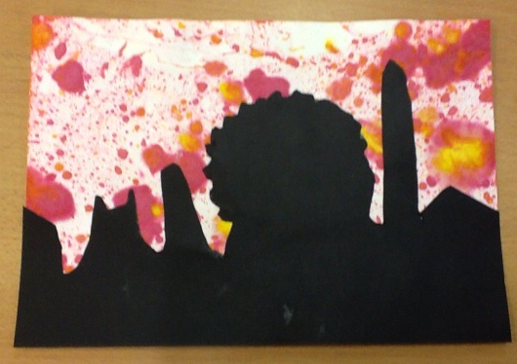
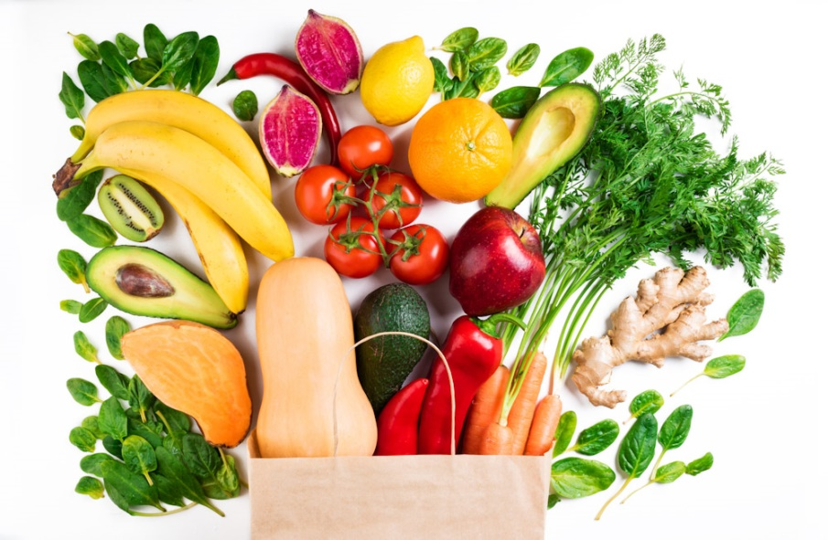
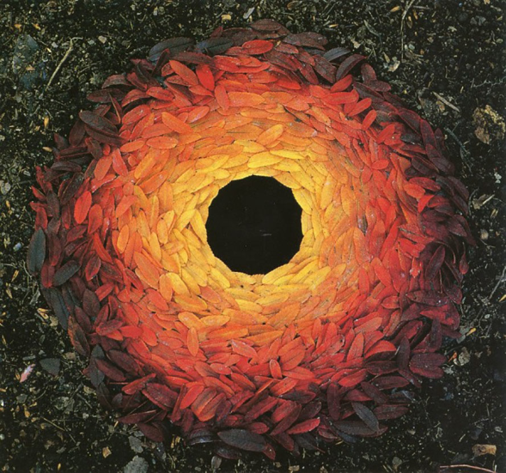
Art & DT
Andy Goldsworthy
Colin Ruffell
John Dyer
Arts Week
Healthy
Eating Week

Slide 9
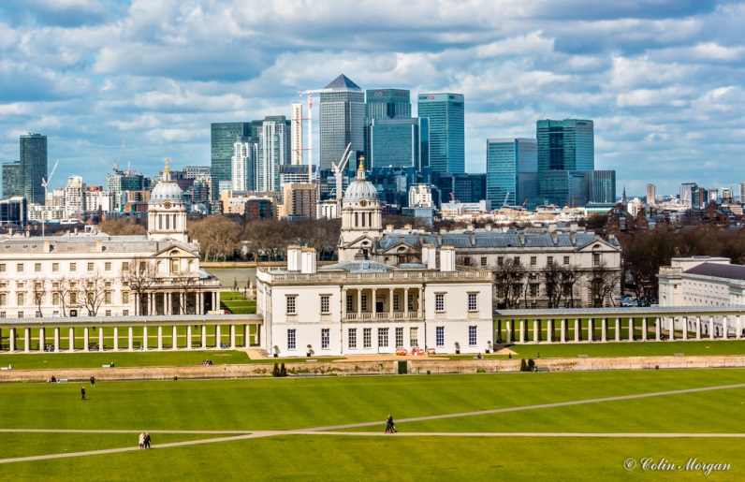
Humanities
Beginning to learn about the past – Gunpowder plot map work & local area united kingdom explorers

Slide 10




RE
Celebrations
Christianity
Islam
Hinduism
Judaism

Slide 11

Music
Weekly lessons
Singing Assembly
Performances

Slide 12
PE
Outdoor & Indoor
Ball Skills
Gymnastics
Dance

Slide 13
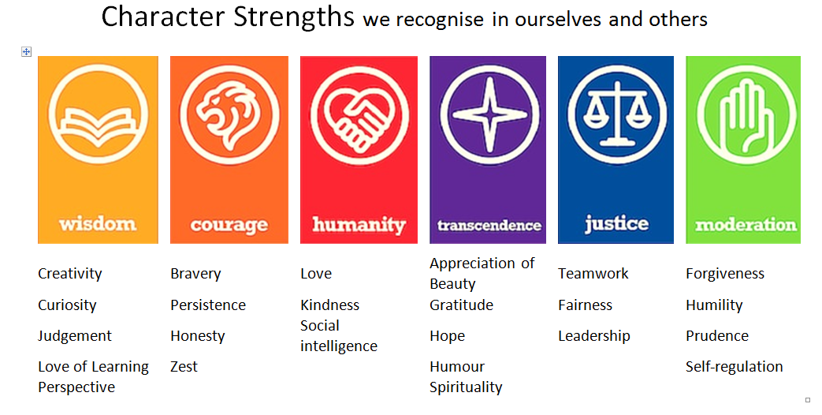
RELATIONSHIPS EDUCATION character strengths weekly RSHE

Slide 14
Computing
Computer suite
Digital Literacy

Slide 15
Thank you

