Slide 1
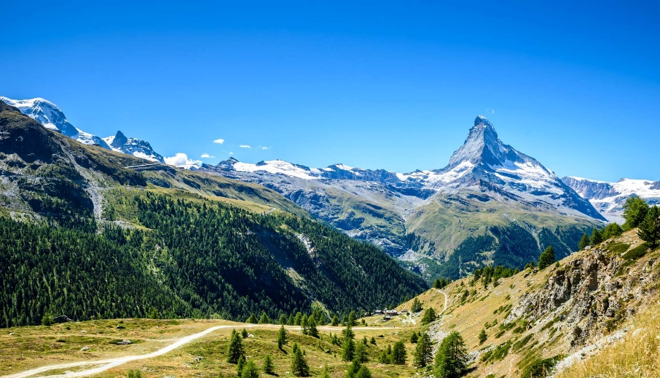
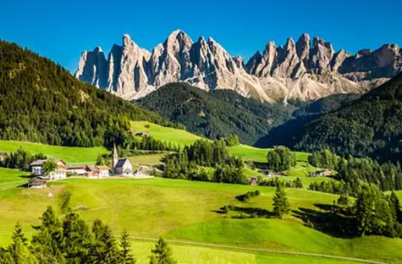
Year 2
Alps
Miss Ali
Ms Bryan
Dolomites
Ms Dulay
Ms Lilburn

Slide 2

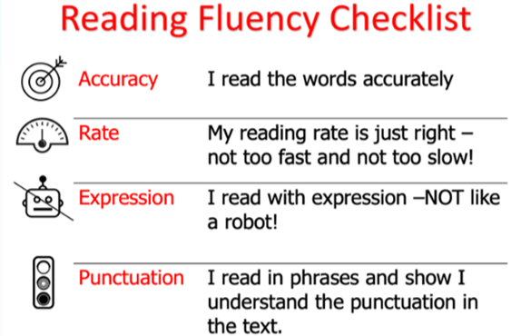
Reading
Daily:
Phonics
Reading
Book change days – will vary but attainment-based books will be changed weekly
Thursday (book corner book)

Slide 3
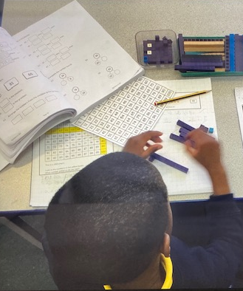

Maths
Maths – fluency, varied fluency, problem solving. CPA approach

Slide 4


English
Core texts
Writing genres
Grammar
Weekly:
Handwriting
Spelling

Slide 5
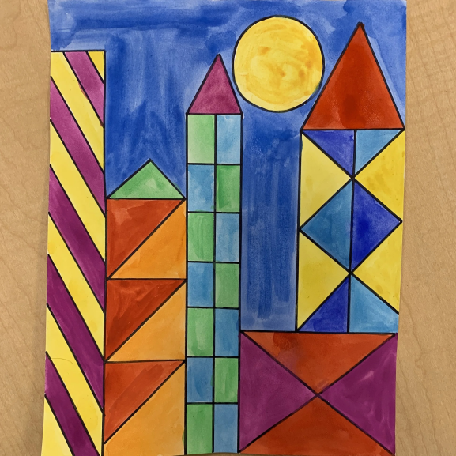

Art/DT
Autumn Term:
Can buildings speak?
Healthy Eating: Novembites!
Spring Term:
Safari vehicles – wheels/axels
Summer Term:
African pattern – Ting-Tinga
Arts Festival

Slide 6

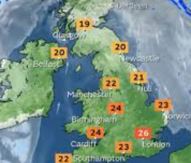
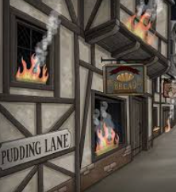
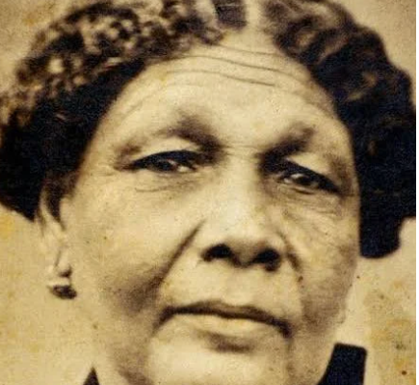

History and Geography
Autumn Term:
WW1/ Remembrance
UK Weather
Spring Term:
Mary Seacole and Florence Nightingale (influence on NHS)
Mountains and coasts
Summer Term:
The Great Fire of London
Comparing Accra and London

Slide 7
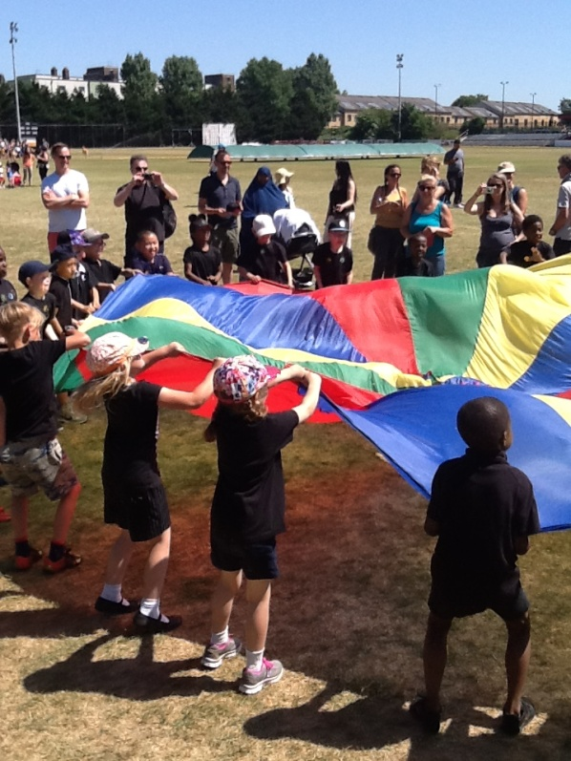
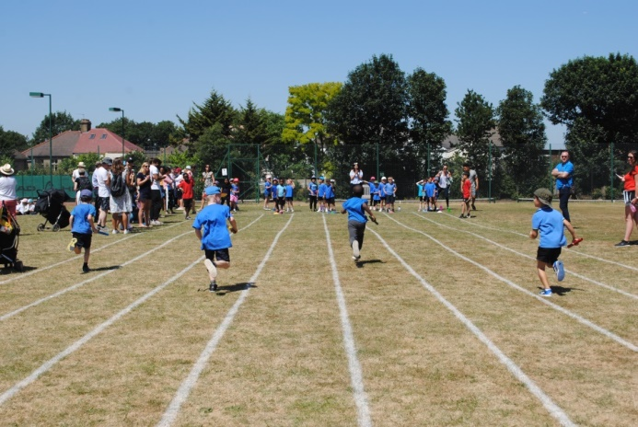
PE
Indoor PE - Tuesday
Dance
Gymnastics
Fitness
Outdoor PE - Thursday
Hit, Catch, Run
Attack, Defend, Shoot
Handball, Rounders, Netball
Sports Day

Slide 8
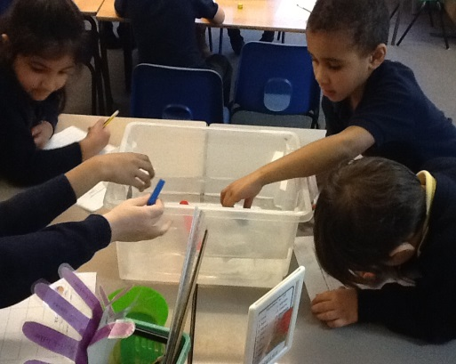
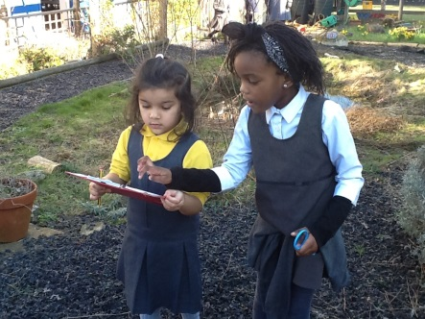
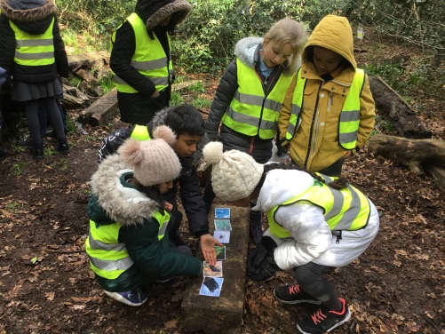
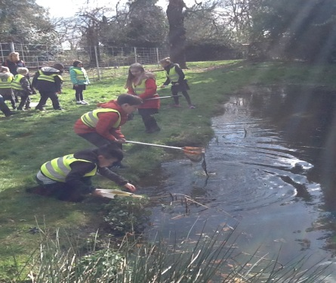
Science
Living things and their habitats
Animals including humans
Materials
Plants
Science Week - January

Slide 9

RE
Islam - Five Pillars
Christianity - A local church
Who am I (belonging)
Christianity - Easter and symbols
Judaism - Festivals
Hinduism - Worship

Slide 10

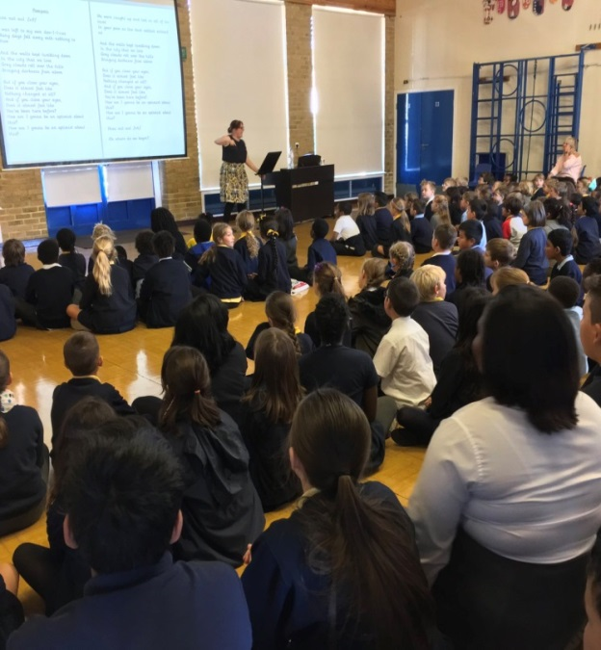

Music
Weekly music lessons in the music room – Charanga
KS1 singing assemblies weekly
Junior choir –Wednesday from 8.10am
Harvest assembly (autumn term)
Christmas nativity (autumn term)
Spring concert (spring term)
Arts Week production (summer term)

Slide 11
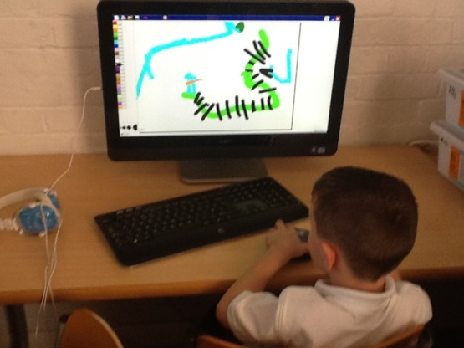
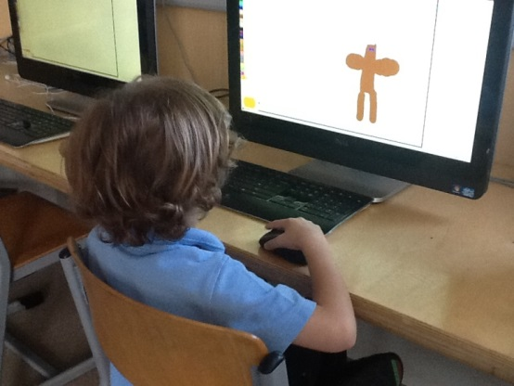
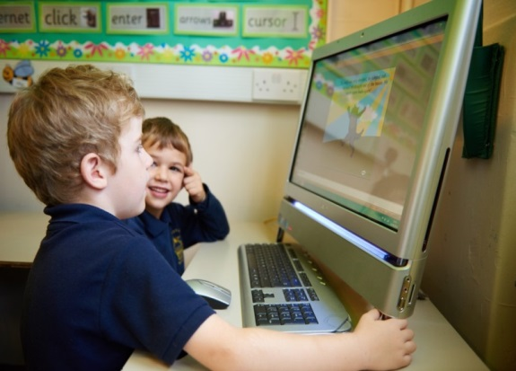
Computing
Weekly computing lessons in ICT suite
Use of iPads in different areas of learning
Linking ICT skills with humanities topics
Programming, IT around us, researching and presenting.

Slide 12
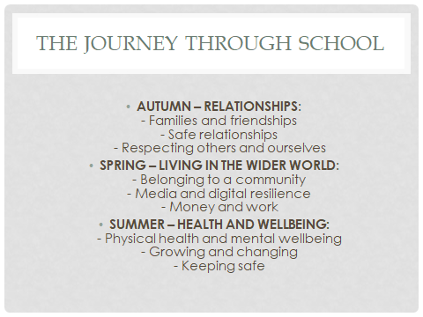
PSHE

Slide 13
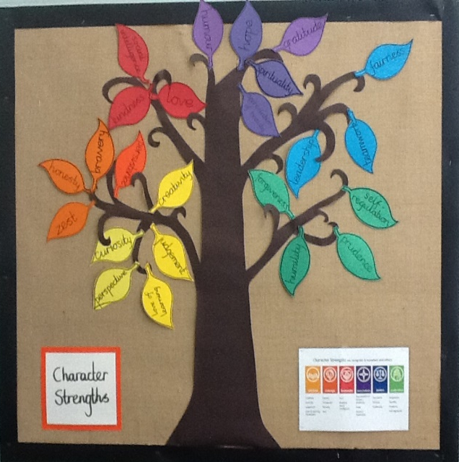
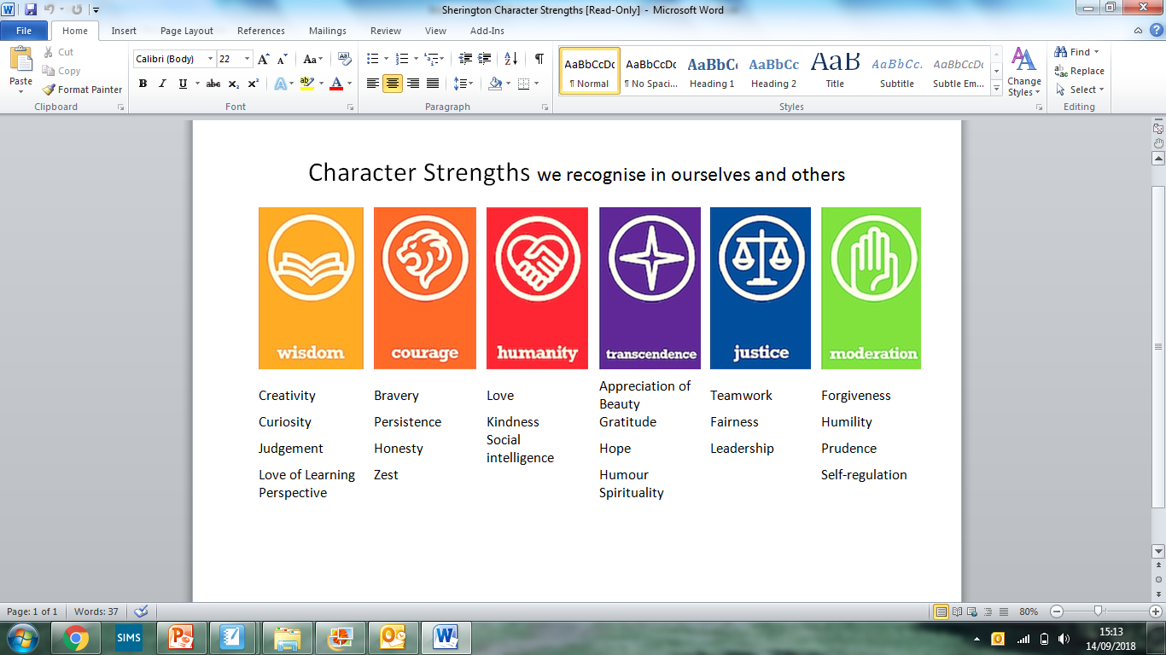
Sherington virtues
Something that lies at the heart of Sherington is the children’s positive attitude to their own personal development and that of their peers.
The overarching aim of PSHE is to help children to develop the knowledge, skills and values to become healthy, happy, safe, confident, respectful and responsible members of our community – both now and in the future.
Year 2 – WISDOM assembly – 26 November 2026

