Slide 1

Class: 4E – Everest
Teacher: Miss Edwards
Class: 4H – Himalayas
Teacher: Miss Hawkins
LSA’s: Miss Thomas & Miss Lilburn

Slide 2


Slide 3


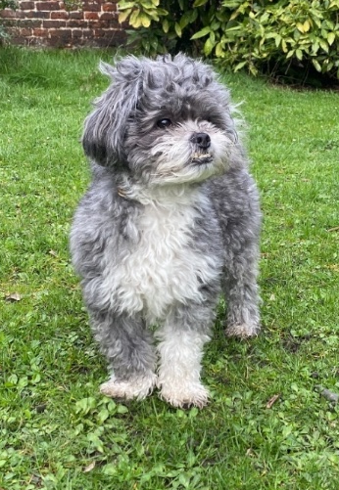
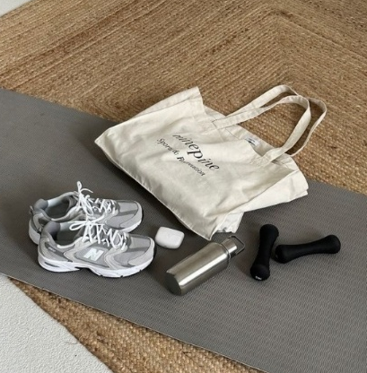

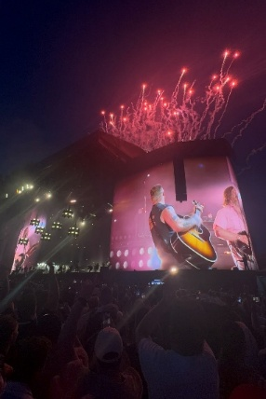
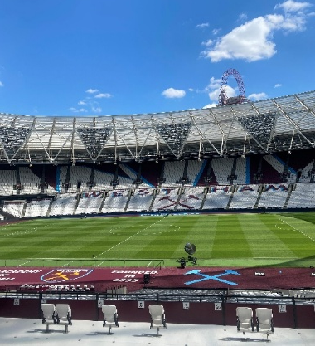
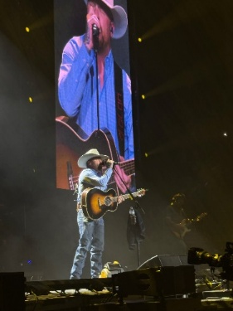
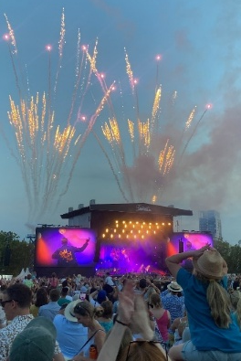
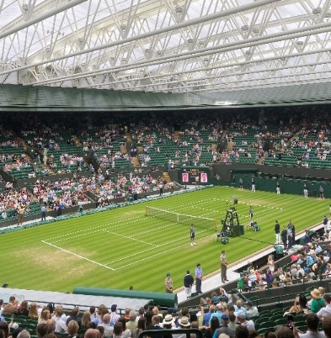
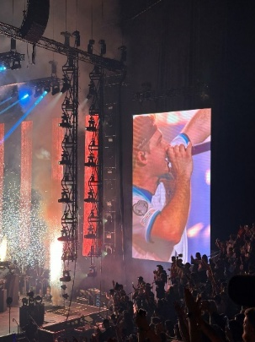
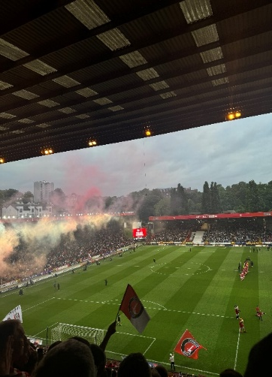
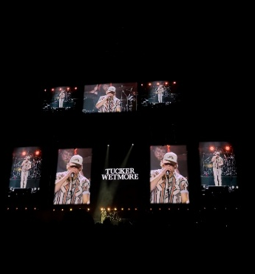
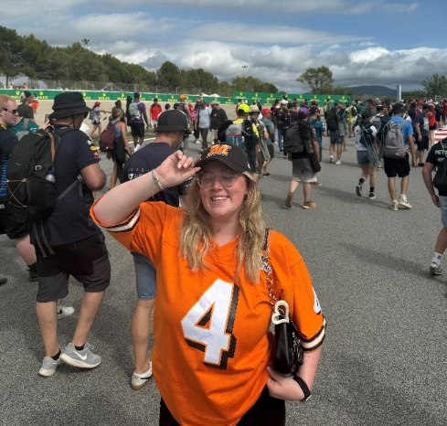
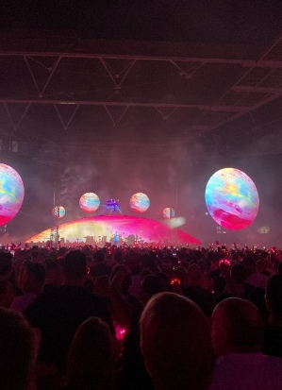
Notes:
WHAT ATTRACTED ME TO SHERINGTON/ PAST EXPERIENCES/ FUN STUFF

Slide 4






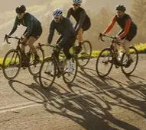
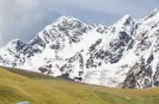
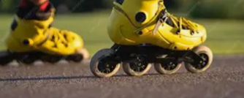

Slide 5
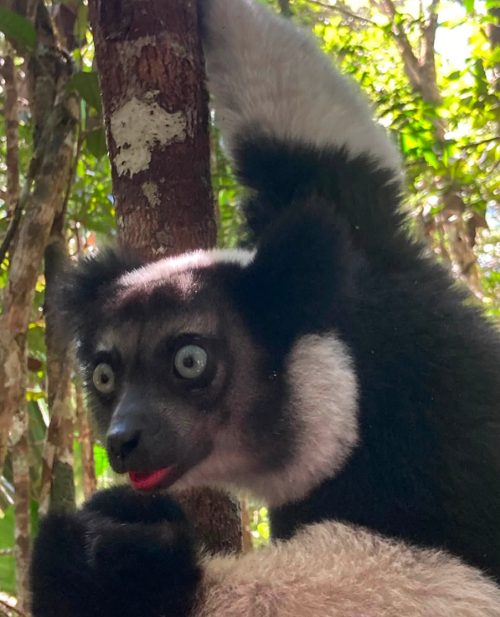
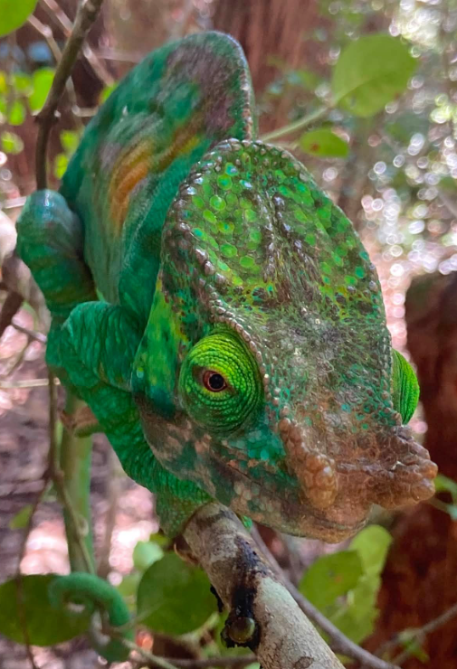
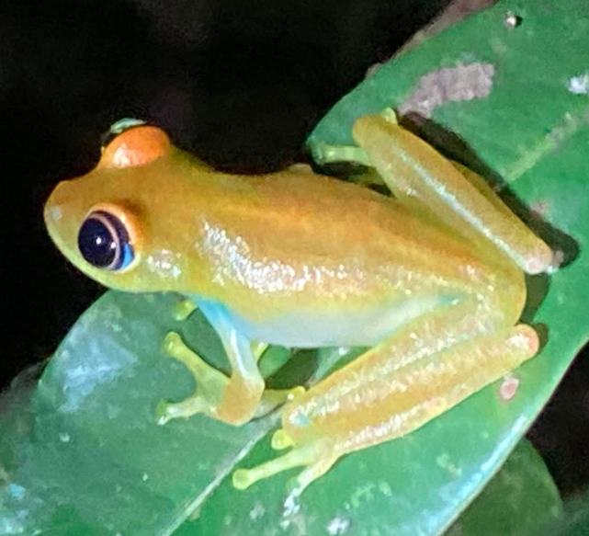
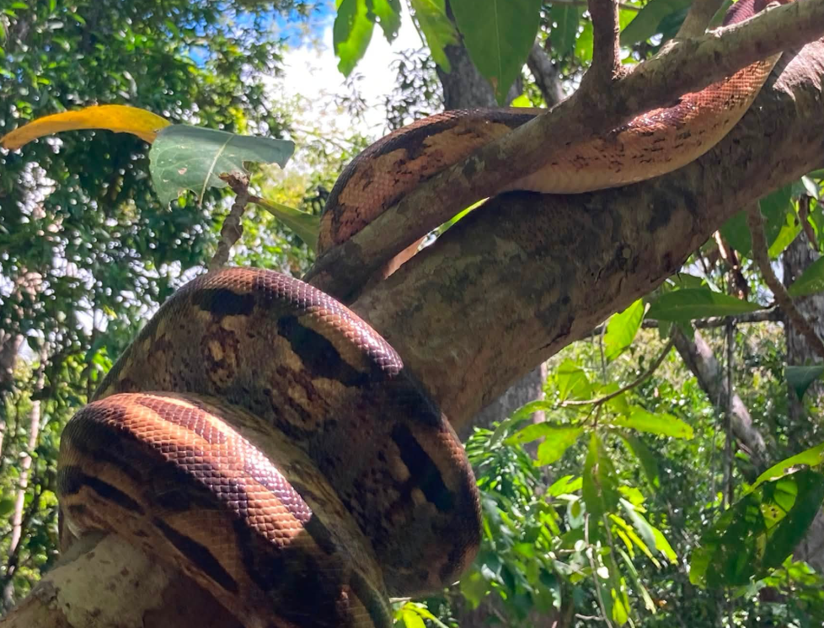
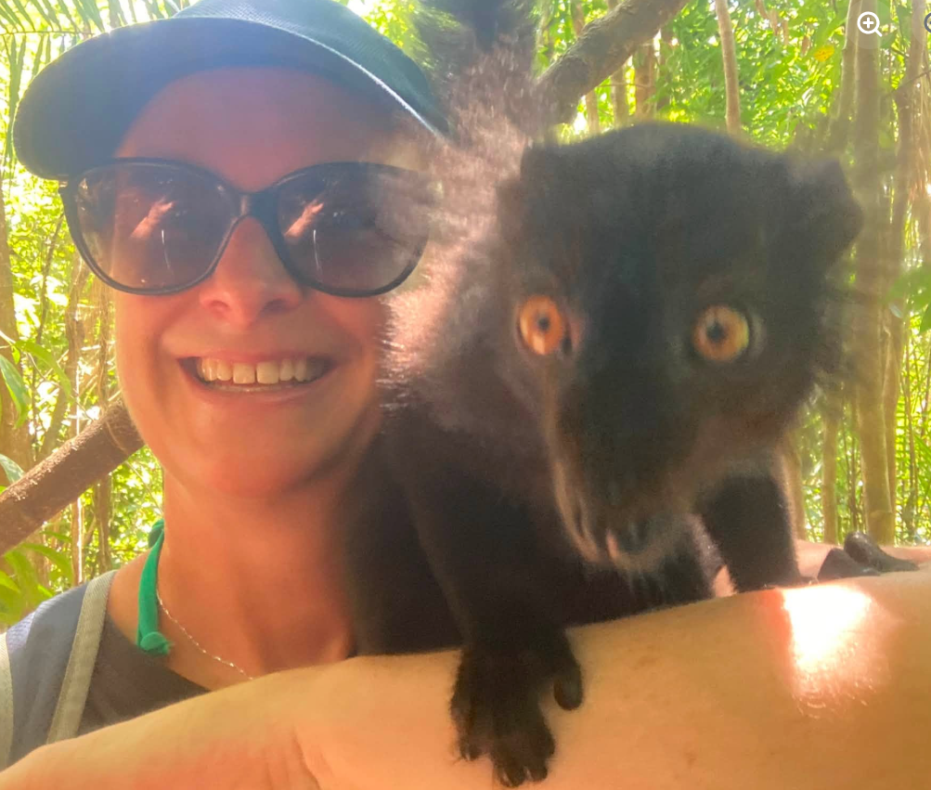
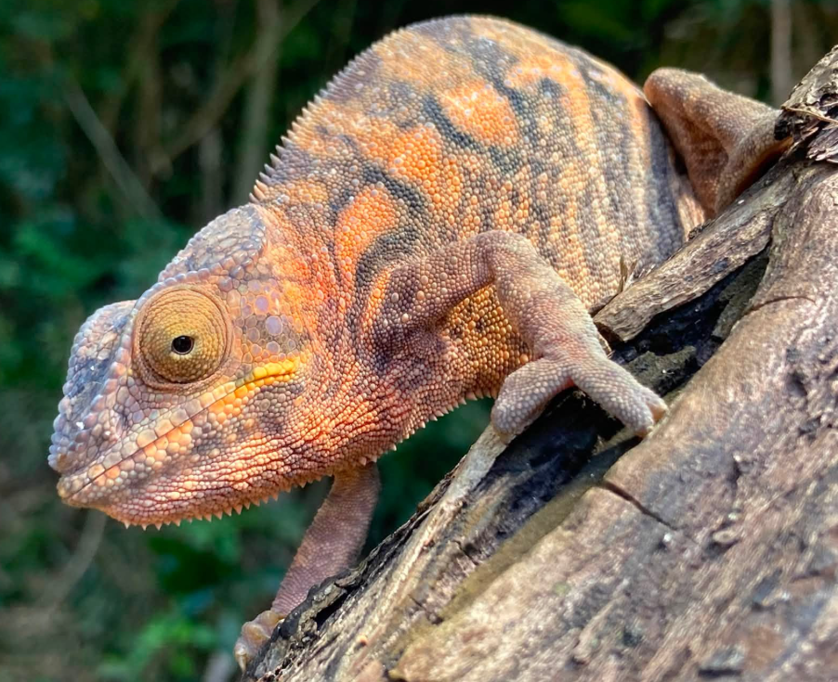

Slide 6






English
Core texts:
Grammar
Handwriting
Spellings – Every Friday!
Notes:
LH

Slide 7
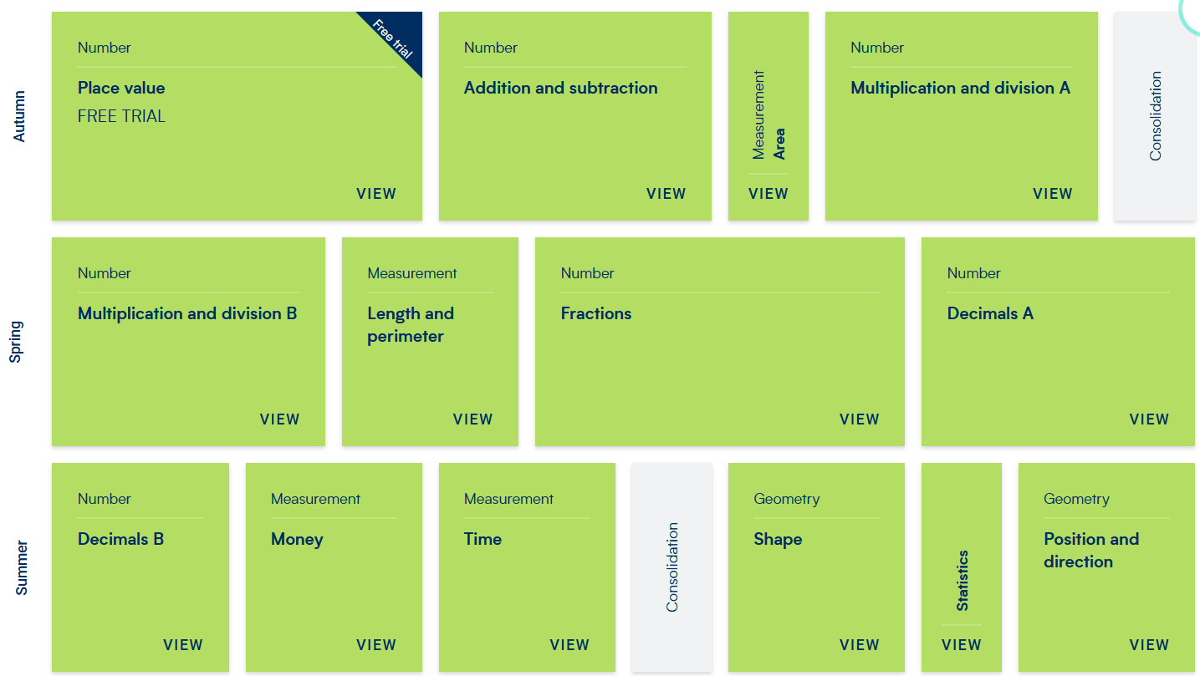
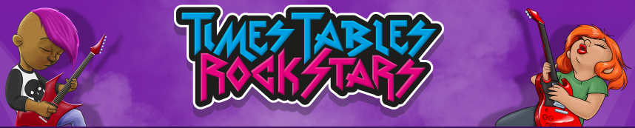

Maths
Arithmetic and key skills
Fluency
Varied Fluency
Problem solving and reasoning
Times tables focus and games
MTC – June 2027
Notes:
KE

Slide 8





Reading
Read aloud:
Reading for pleasure:
Books changed every Friday!
Reading skills
Notes:
LH

Slide 9



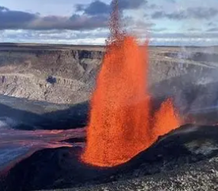

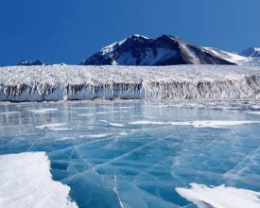
History and Geography
Notes:
KE Romans and why they invaded, Julius Ceasar and Boudicca. Rise of British Empire (trade routes and advances in technology). Reformation (protestants and catholics and the importance of the pope and Henry VIII and his many wives! As well as dissolution of the monasteries. Climate zones from tropical to polar and significance of the equator and tropics of Capricorn and cancer how this affects temperature, as well as time zones. Polar regions (buzz day). Arctic and Antarctica – glaciers! Personal favourite! Volcanic eruptions personal favourite.

Slide 10
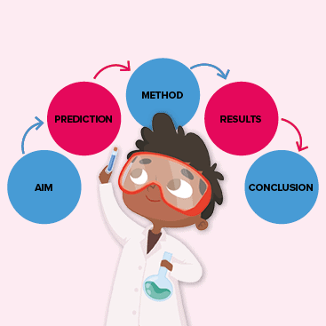
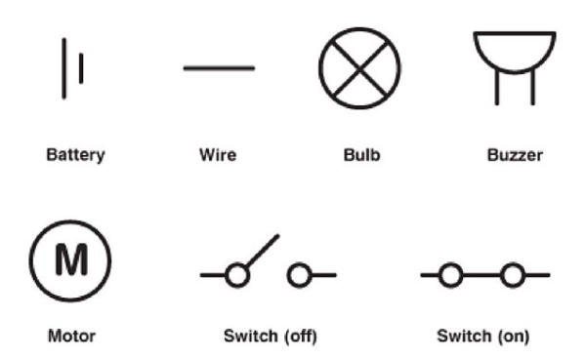
Science
Units of work:
Sound
Electricity
States of Matter
Animals including Humans
Living Things and their Habitats
Science Week
Notes:
LH

Slide 11


French
Family
Clothes
Animals
Pets
Fruits
Vegetables
Notes:
KE Use of games, songs and videos to support learning to make lessons fun, interactive and engaging. 4 key skills, grammar focus. Enrichment learn about French city or overseas territory

Slide 12
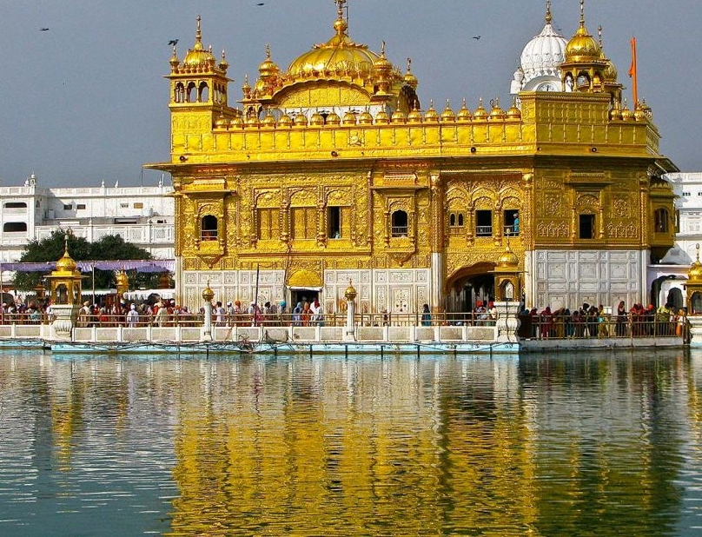
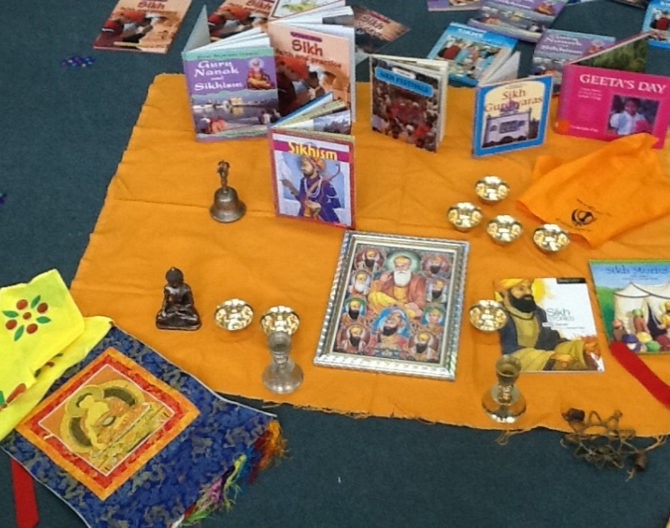
RE
Autumn term:
Sikhism & Hinduism
Spring term:
Islam & Judaism
Summer term:
Buddhism & Christianity
Notes:
LH

Slide 13


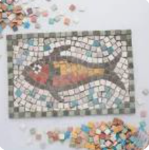

Art & Design and DT
Arts Week!
Notes:
KE: key skills of design, make and evaluate. All art and DT to have strong cross curricular links. Arts Week, top secret at the moment

Slide 14




Music
Weekly music lessons in the music room.
KS2 singing assemblies weekly and termly celebrations/Arts Week
Children can develop their skills in listening, performing, composing and appraising.
Notes:
LH

Slide 15
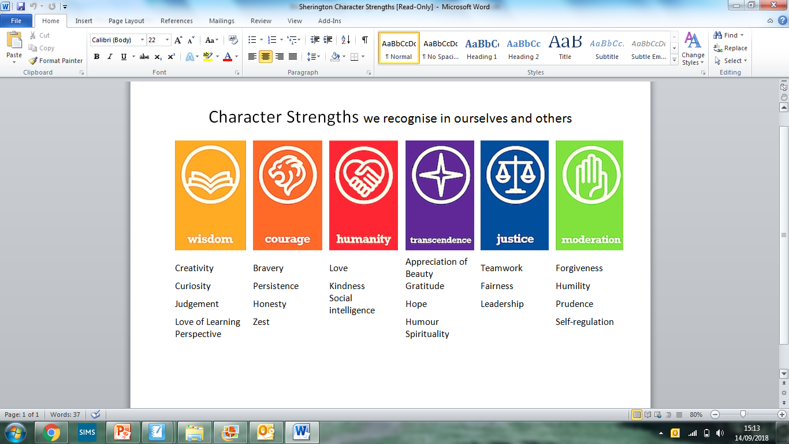
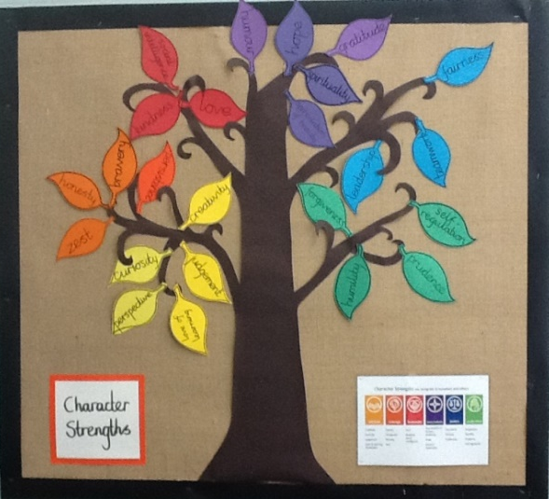
PSHE
Virtues Assembly
Transcendence
Relationships | Living in the wider world | Health and wellbeing
Families and friendships Safe relationships Respecting others and ourselves | Belonging to a community Media and digital resilience Money and work | Physical health and mental wellbeing Growing and changing Keeping safe
Notes:
KE - include worry box. Help children to build their confidence, self esteem and have an open platform to discuss ideas, concerns.

Slide 16

Computing
Weekly computing lessons in ICT suite with
Mr McNamara:
Programming (coding)
Presentations
Using CAD
to make products, such as a
Roman arrowhead
Animation…
Class iPads – used in different areas of learning
Notes:
LH

Slide 17




PE
Outdoor PE (Wednesdays)
Basketball
Cricket
Football
Handball
Netball
Athletics
Indoor PE (Mondays)
Gymnastics
Fitness
Dance
Notes:
KE. Have received laminated overiew with days. Teacher alongside Mr Flynn. Number of clubs to join to further develop skills

Slide 18
Thank you!
Any questions?

