Slide 1
Ms Fawcett
MS UTLEY-PARKER
MS G
Welcome to Year 5

Slide 2






English
Spoken and written English.
Fiction and non-fiction.

Slide 3

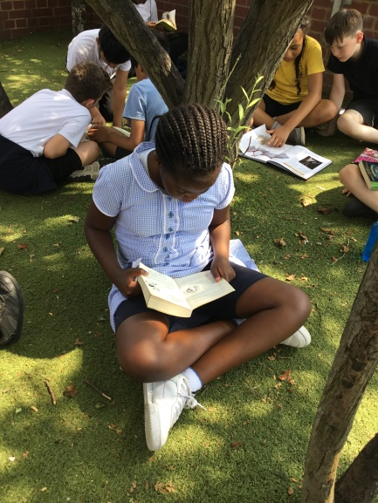
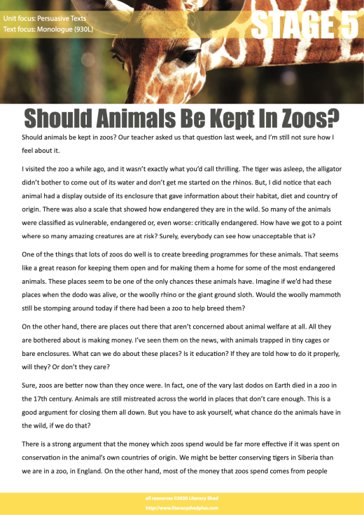
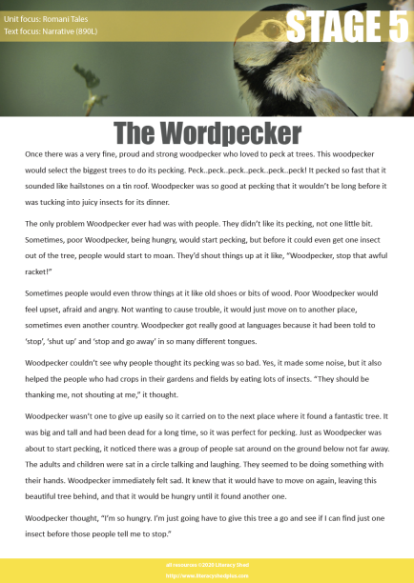
Reading

Slide 4
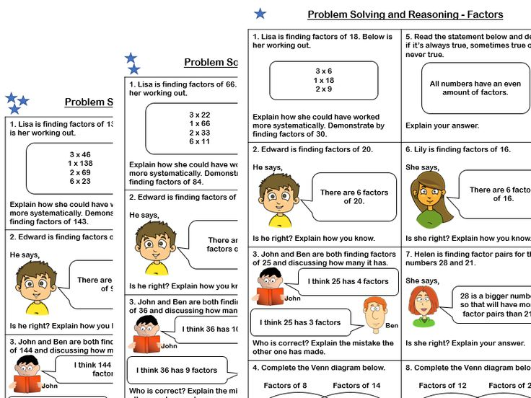
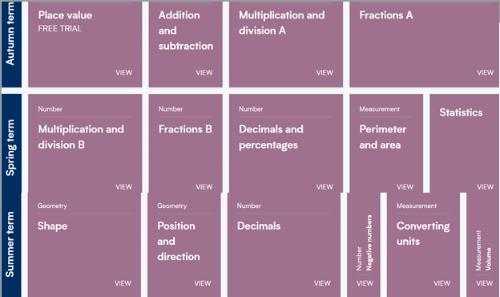
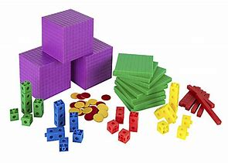

Maths

Slide 5
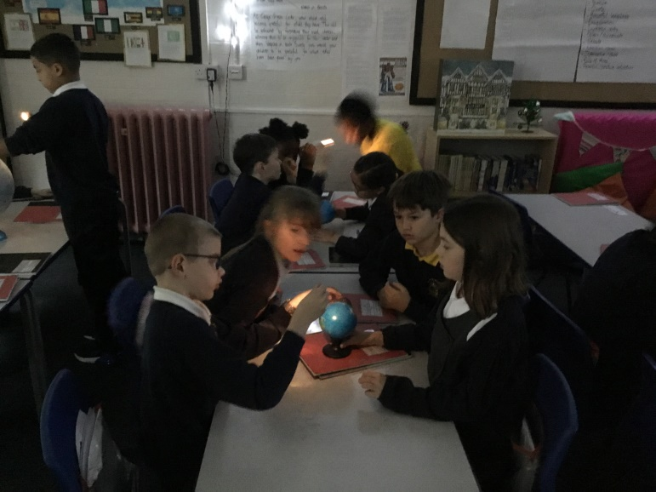
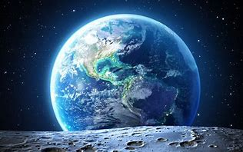

Science
Animals Including Humans
Earth and Space
Forces
Properties of Materials
All Living Things
Science week

Slide 6
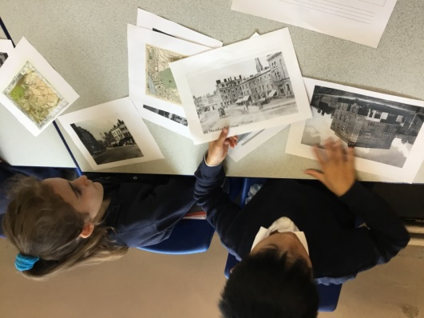

Humanities
History and Geography curriculums are going through an exciting change

Slide 7
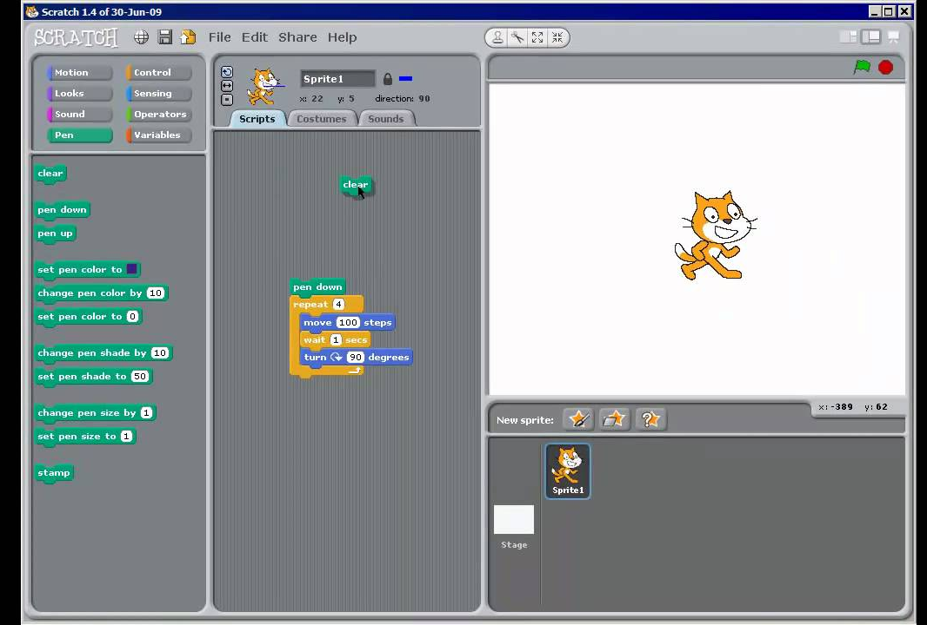

Computing

Slide 8
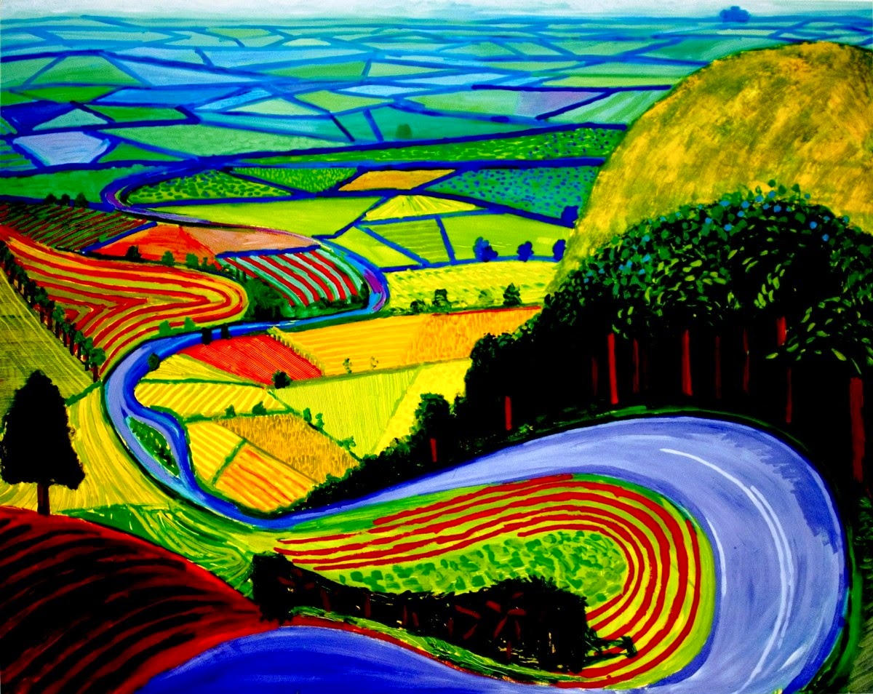

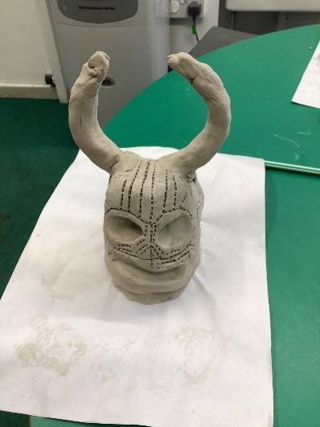
Art & DT
David Hockney
Benin Bronzes
Leah Evans
Arts Week
Notes:
Last year’s arts week – patterns tying into the lost world which was our literacy focus

Slide 9
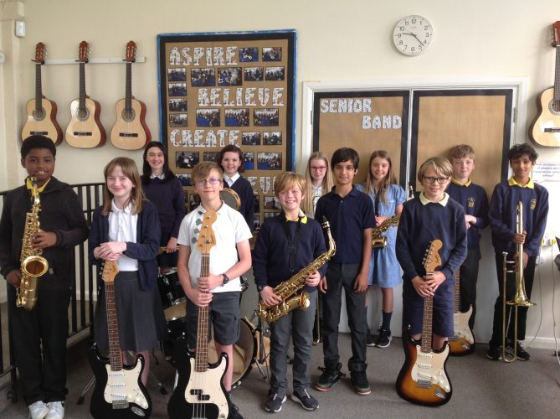
Music

Slide 10
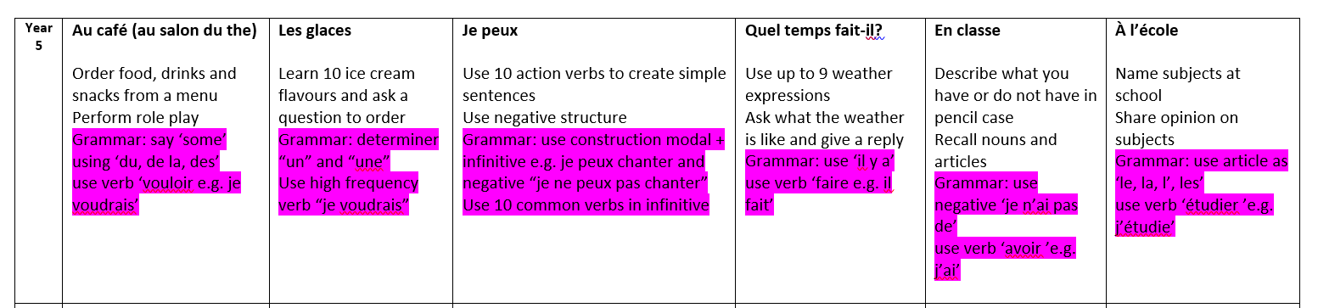

French

Slide 11
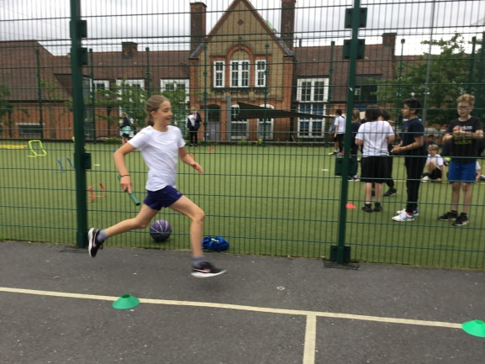
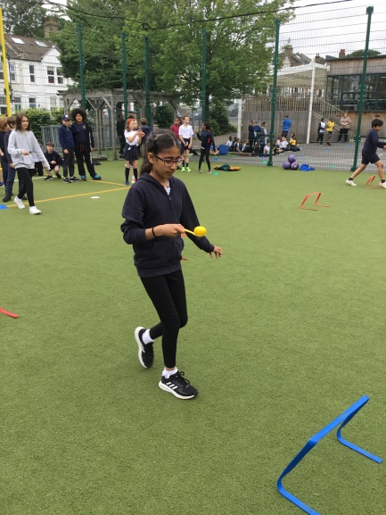
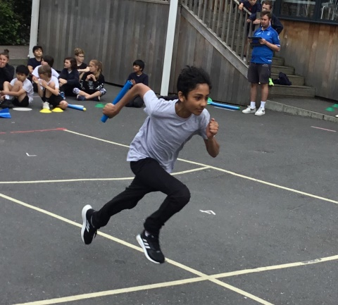
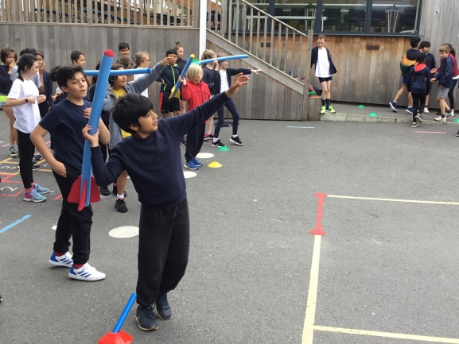
P.E.

Slide 12

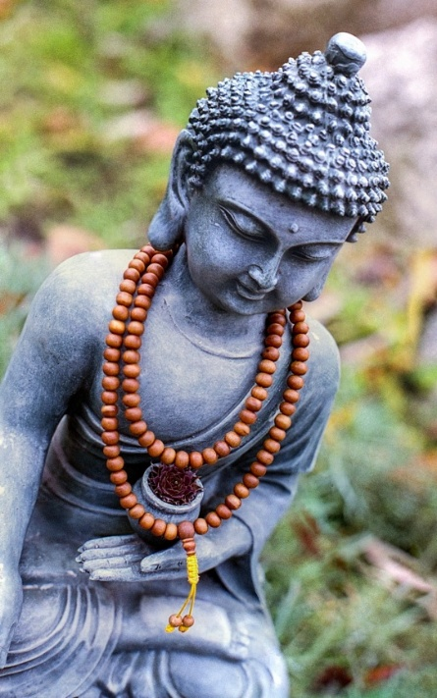



R.E

Slide 13


Slide 14
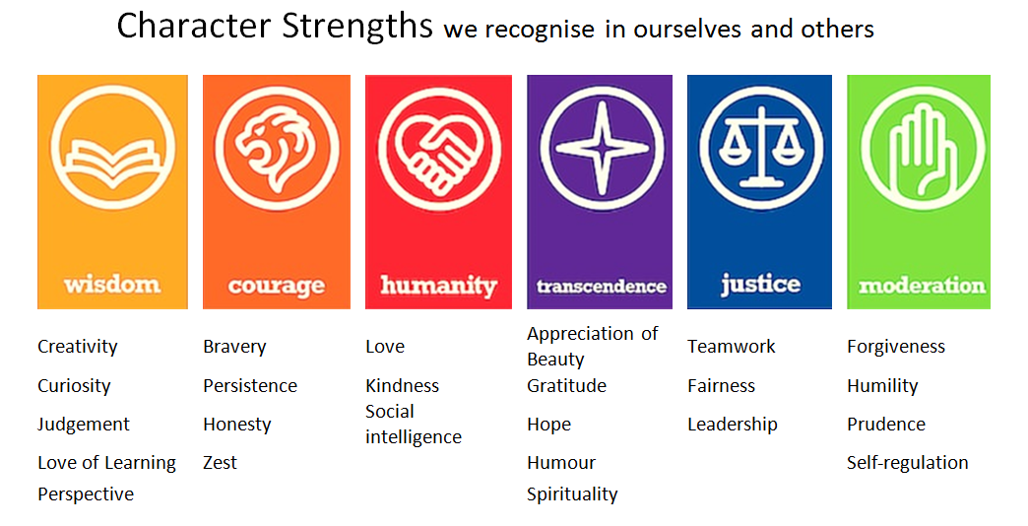

Slide 15
Thank you!

