Slide 1
WELCOME
TO
RECEPTION 2026-27
Miss Bull, Mr Hamdoun, Mrs Lewis, Ms Gurjit,
Miss Hardy and Miss Townsend

Slide 2
This session aims to give you:
An overview of the Early Years Framework.
An understanding of the way early reading, writing and maths are taught at Sherington.
An idea of how you can support your child’s learning at home.

Slide 3
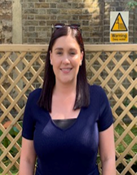
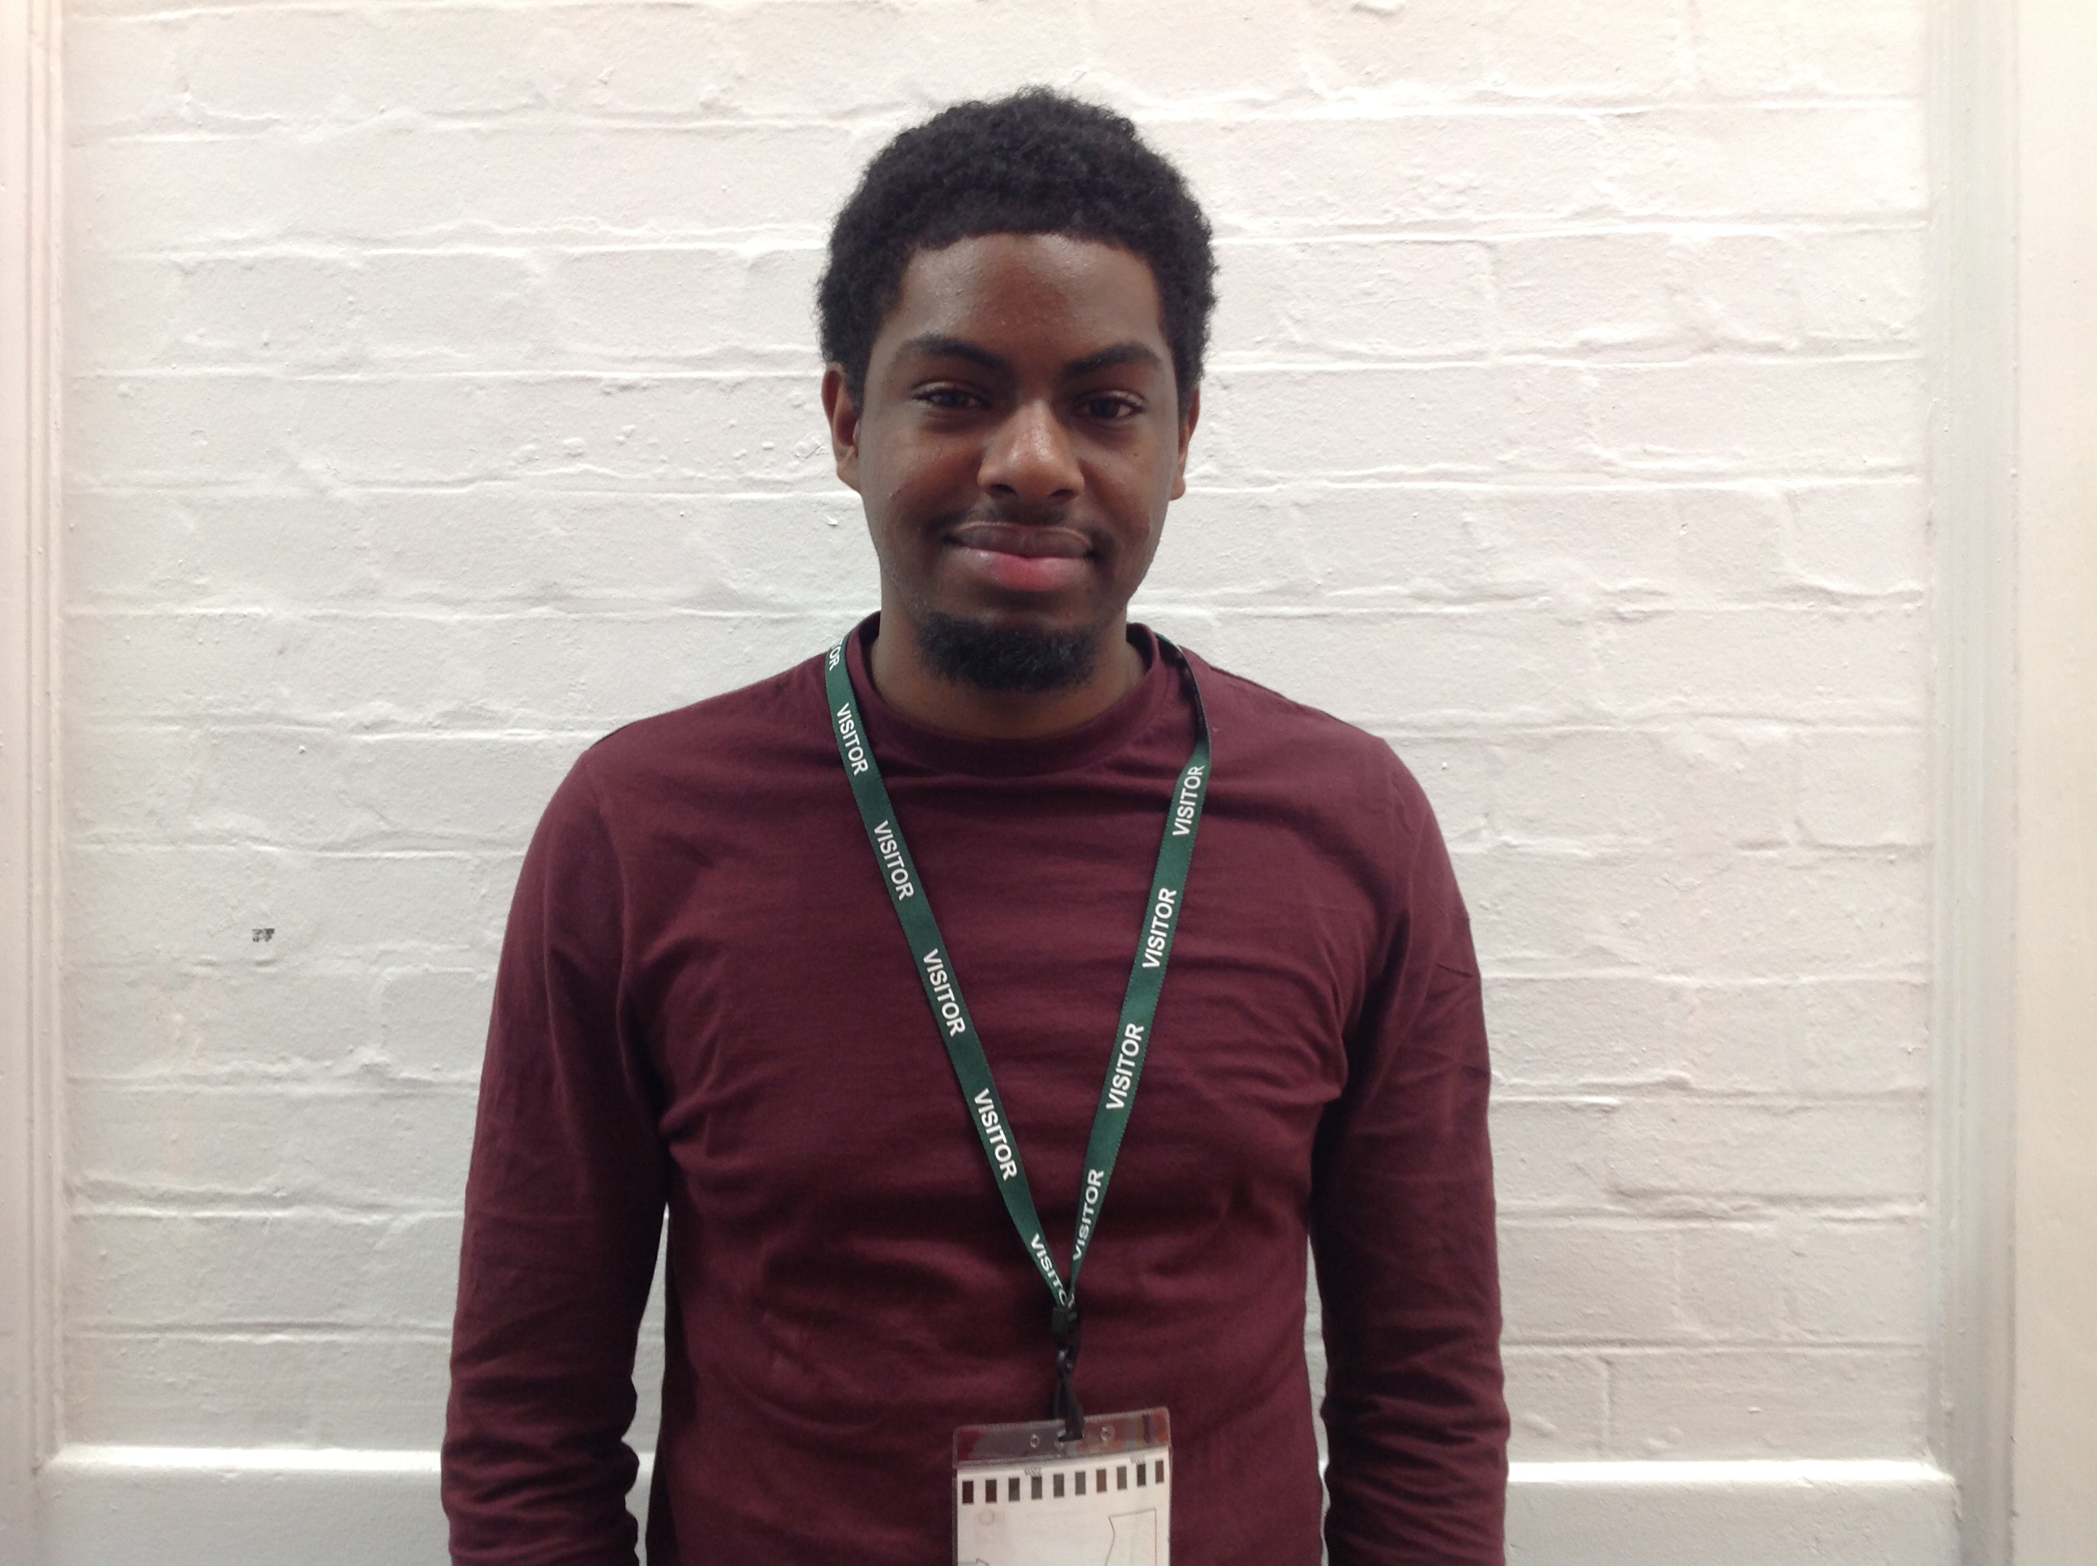
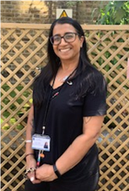
BLUE CLASS aka Bluey’s
Miss Bull, Mr Hamdoun, Miss Lewis and Ms Gurjit

Slide 4
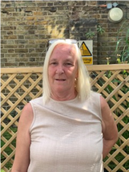

HIDA CLASS aka Hida’s
Miss Hardy, Miss Townsend and Ms Gurjit

Slide 5
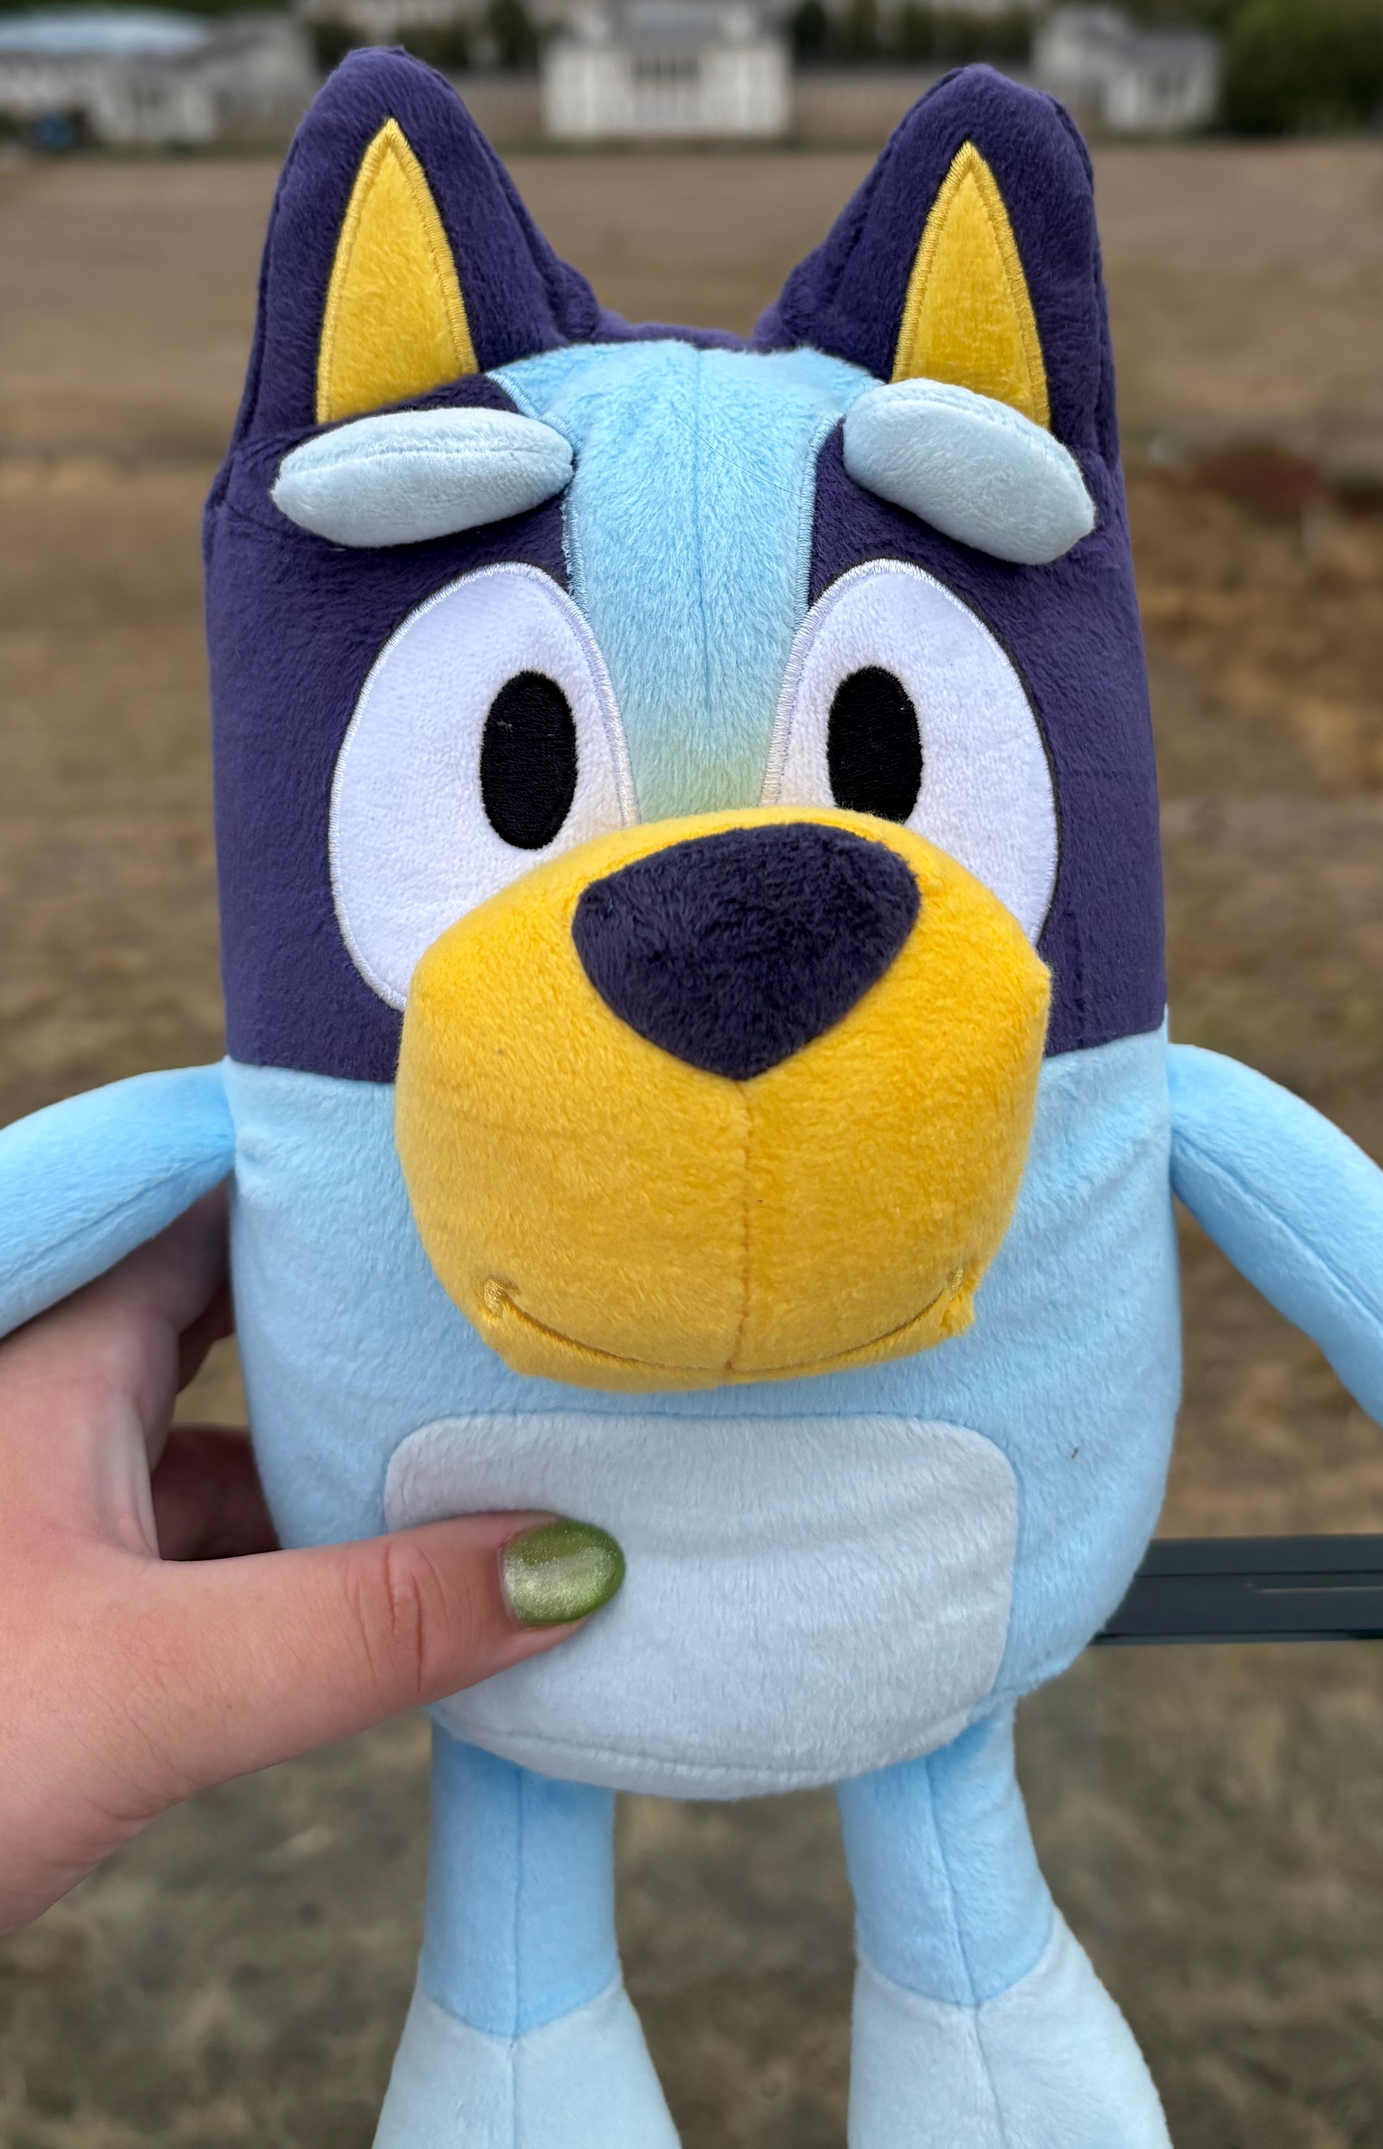
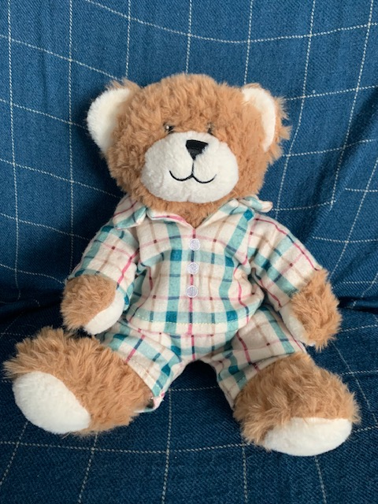
Bluey and Hida’s Bear Adventures!
Every Friday, a child will be entrusted to look after Bluey or Hida for the weekend. Wahoo!
Bears will need to be returned to school on the following Monday.
A diary will accompany the bear in which you can share your adventures, should you be able. From shopping trips to parks and cinemas to house work, it’s all exciting to us.
Bluey and Hida love spending time with the children and their families, and are much loved. We ask that you take care of the them whilst with you.
Should you require support with printing photos, please send them to the sao email address with Bluey or Hida in the title.

Slide 6

Character Strengths
Creativity
Curiosity
Judgement
Love of Learning
Perspective
Bravery
Persistence
Honesty
Zest
Love
Kindness
Social intelligence
Appreciation of Beauty
Gratitude
Hope
Humor
Spirituality
Teamwork
Fairness
leadership
Forgiveness
Humility
Prudence
Self-regulation

Slide 7
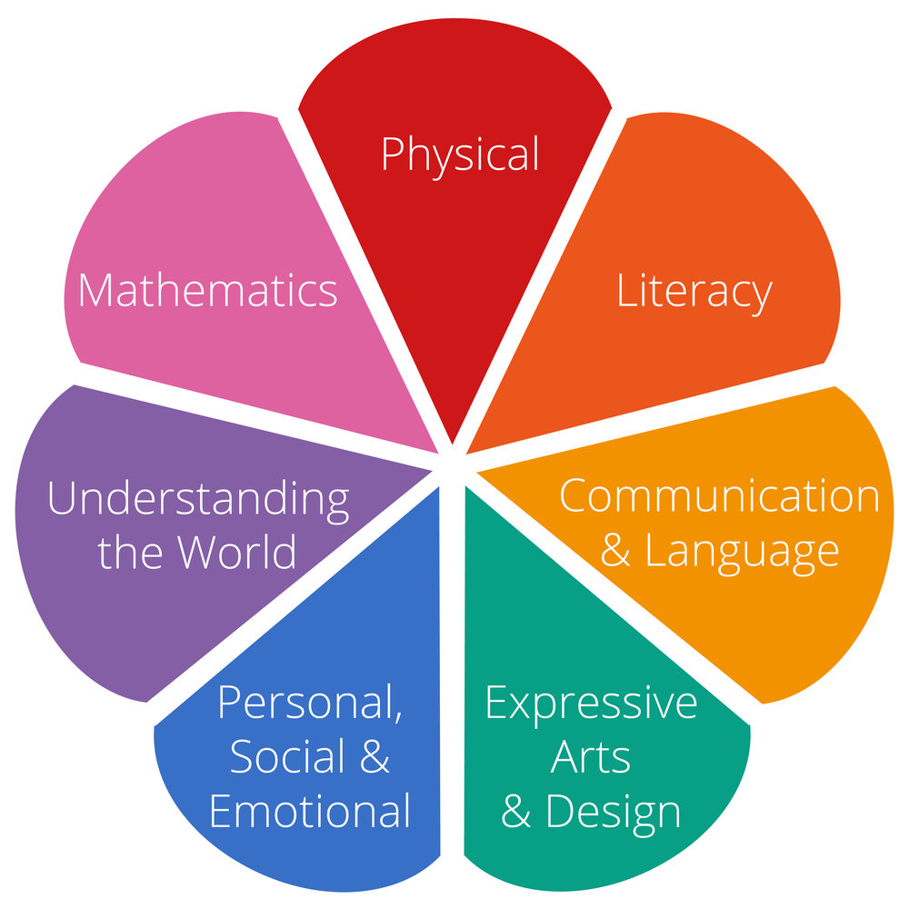
Early Years Framework

Slide 8



Literacy:
Children have daily 20 minute literacy lessons
Skills gained in literacy lessons:
  Re-telling stories
  Sequencing
  Making predictions
  Forming opinions
  Rhyming patterns

Slide 9

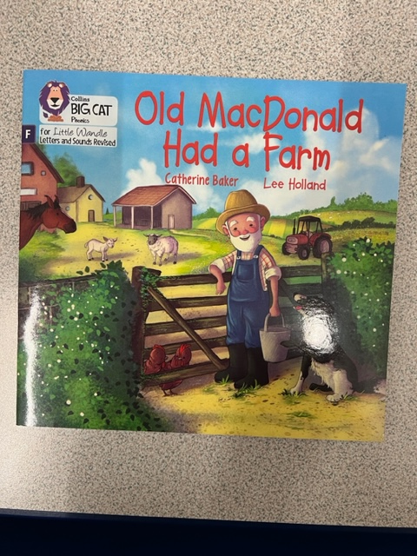
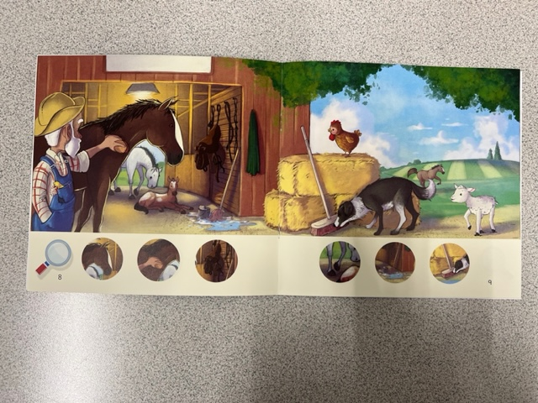
Phonics:
Children have daily 20 minute Little Wandle phonics sessions.
Wordless books are used to develop language, comprehension and begin encouraging story prediction.
Miss Price’s Phonics and Early Reading morning – Monday 12th October.
Phonics is delivered at the beginning of each day so it is imperative that your child arrives to school on time. Missed phonics sessions can lead to a delay in reading fluency as the children develop.

Slide 10

Home Reading Journals
Books are changed every THURSDAY.
Children will come home with 2 books:
-The first will be a wordless Little Wandle book (this will progress into books with words once the children are ready and secure with their sound knowledge);
-The second will be a picture book that will need to be read to the children and enjoyed together.
Book changes will also include a Little Wandle home sound review page for you to work through together in your own time.

Slide 11
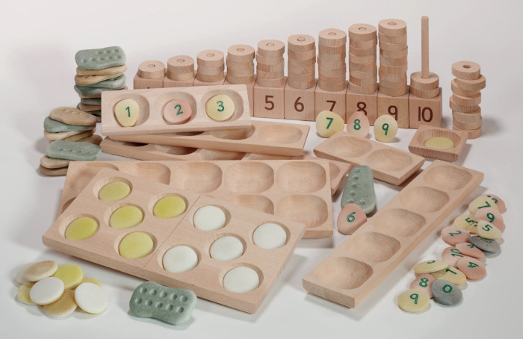
Maths:
Children have daily maths sessions, which last for approximately 20 minutes. These are very practical and take a very hands-on approach.
Sessions are planned weekly and cover all aspects of the Early Years curriculum for maths.
From Autumn 2, we will be planning and delivering our maths sessions through Maths Mastery. This is an approach that aims for children to develop a deep understanding of maths.

Slide 12
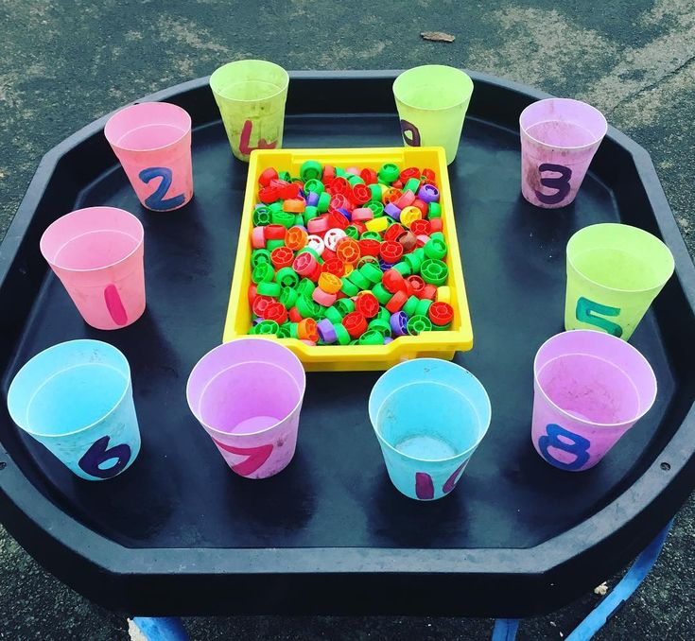
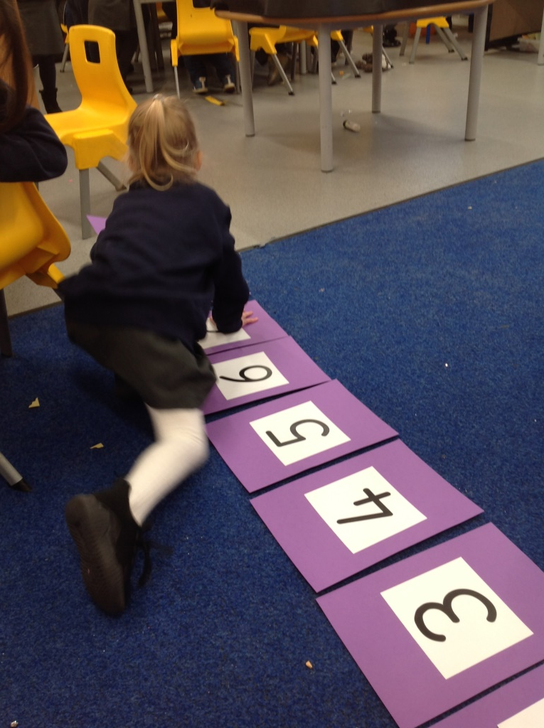
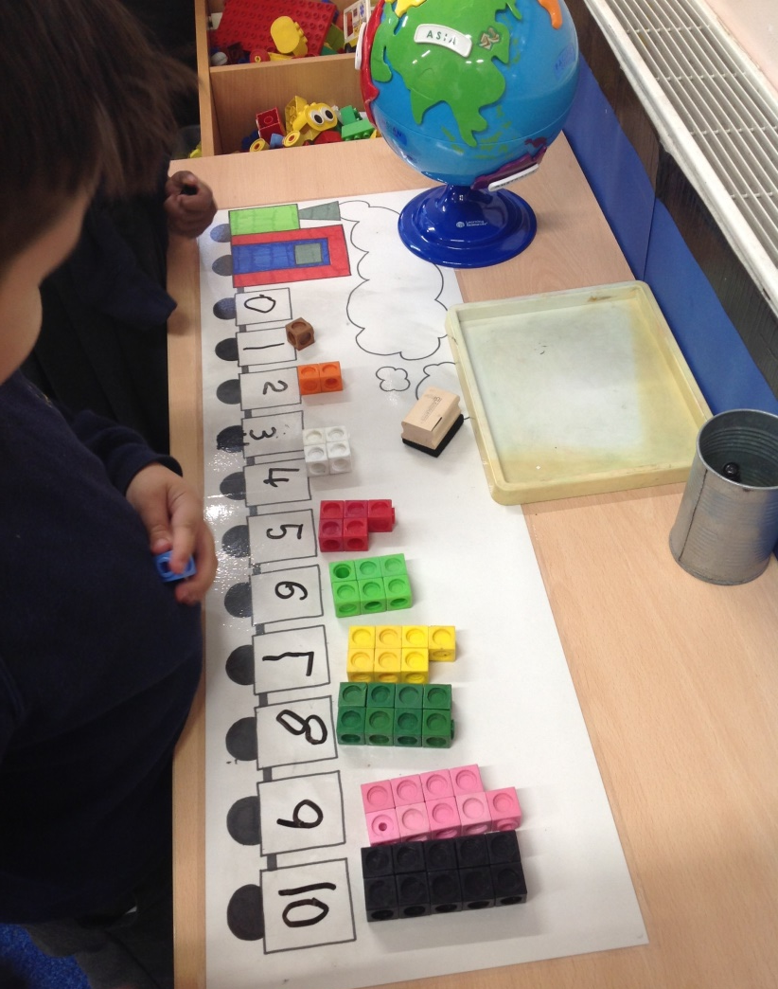
Maths – Number
Deep understanding of number composition, subitising up to 5, automatic recall of number bonds to 5.

Slide 13
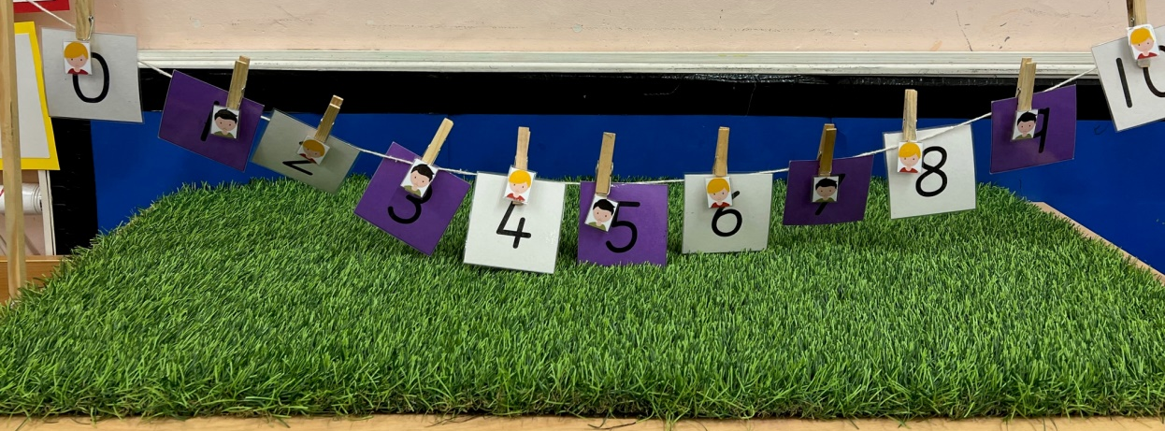
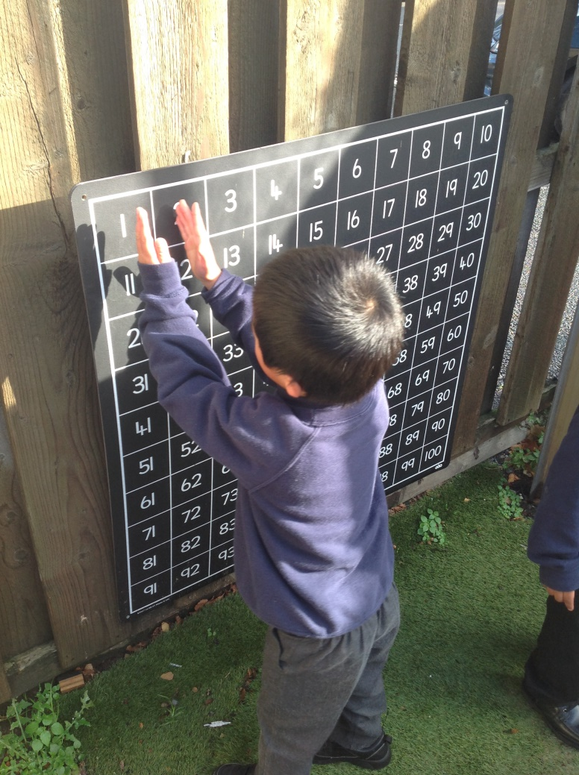
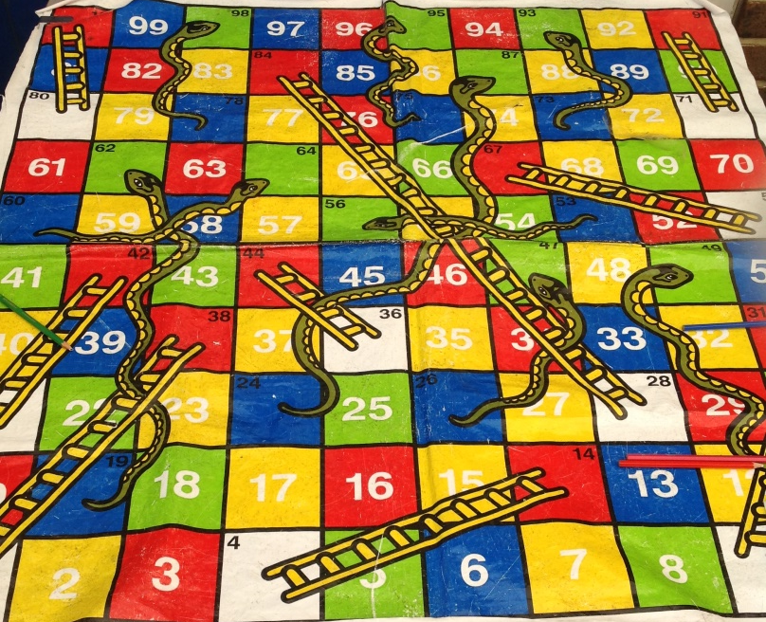
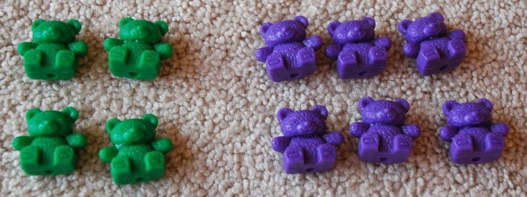
Maths – Numerical Pattern
Sequence of counting, comparing quantities, number patterns.
Odd and even.

Slide 14
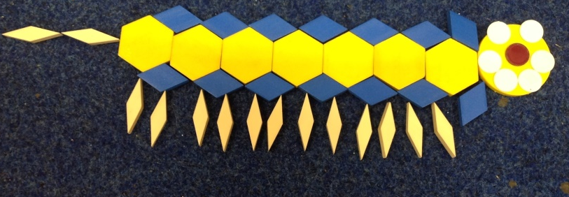
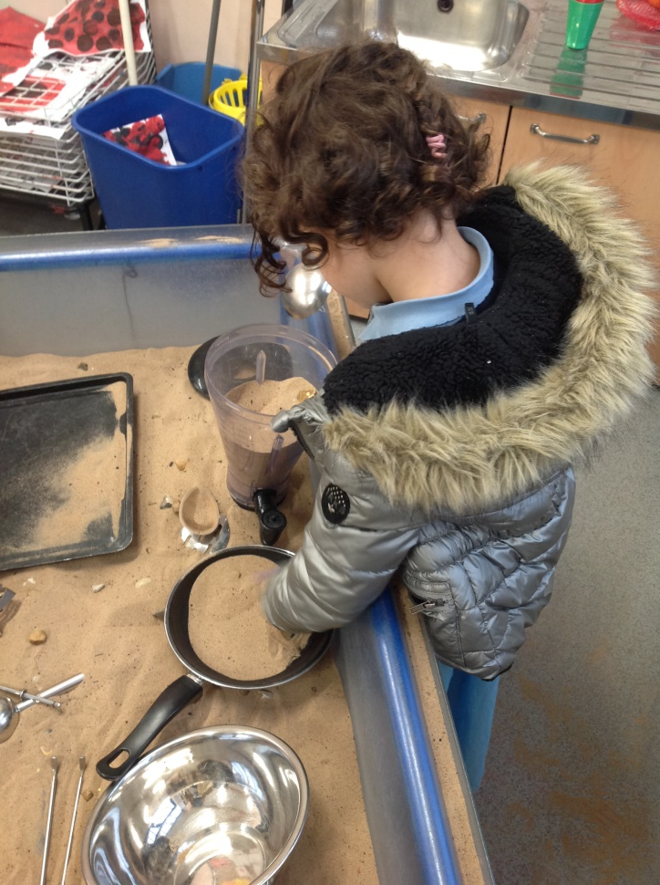
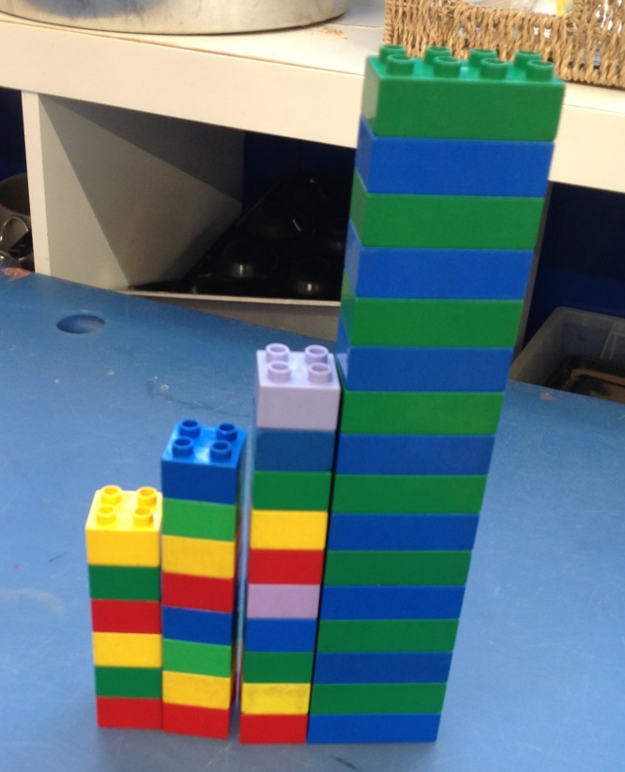
Maths – Shape, Space and Measure
Exploring height, weight, capacity, pattern, 2D shapes.

Slide 15
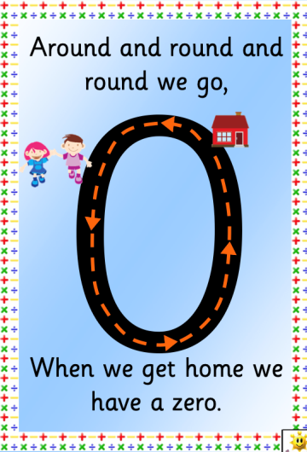
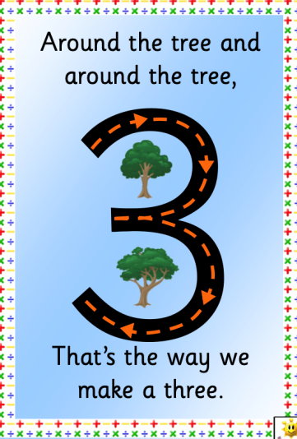
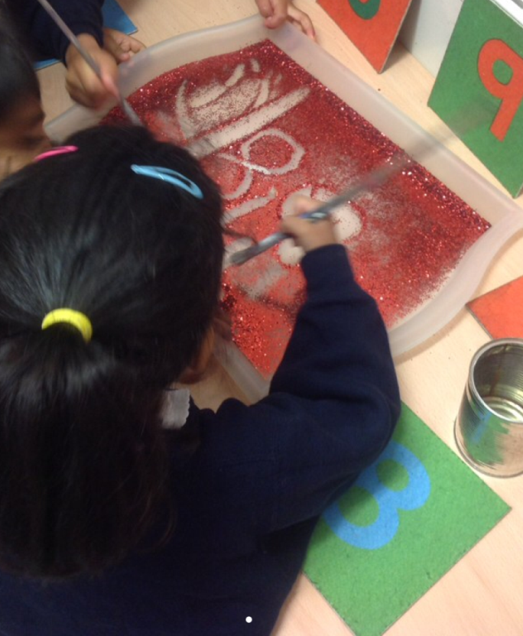
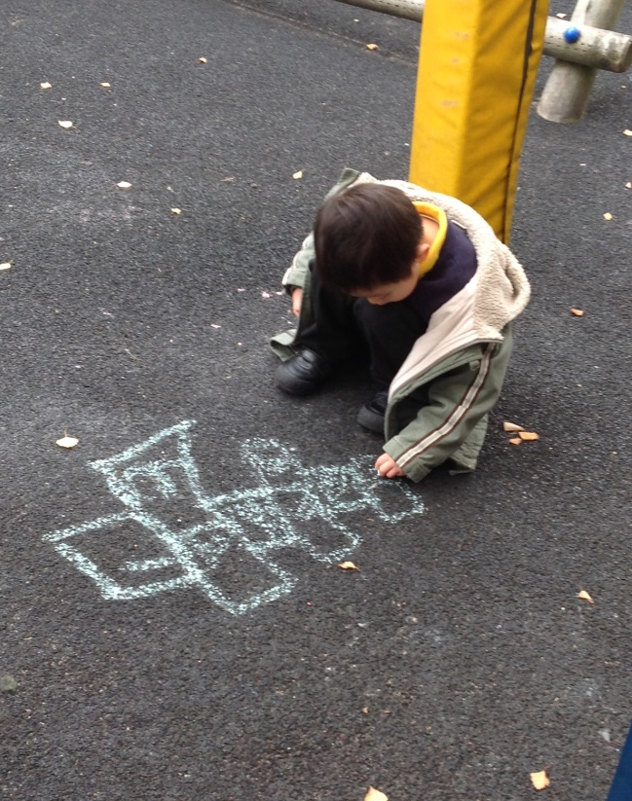
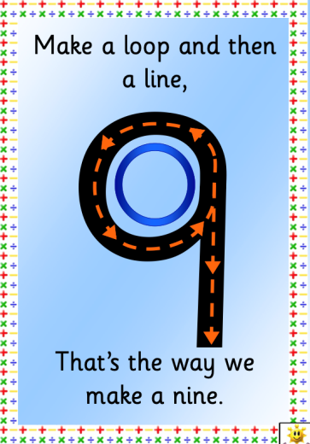
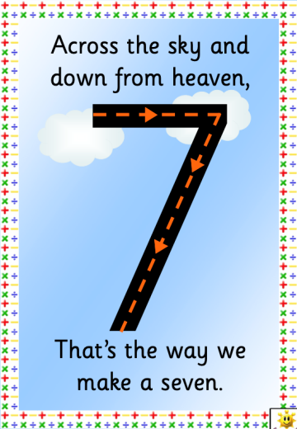
Maths – Number Formation
Practise number formation in fun and engaging ways!

Slide 16
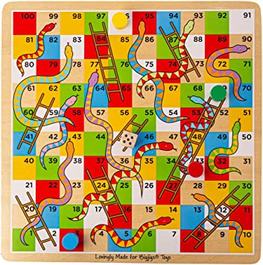
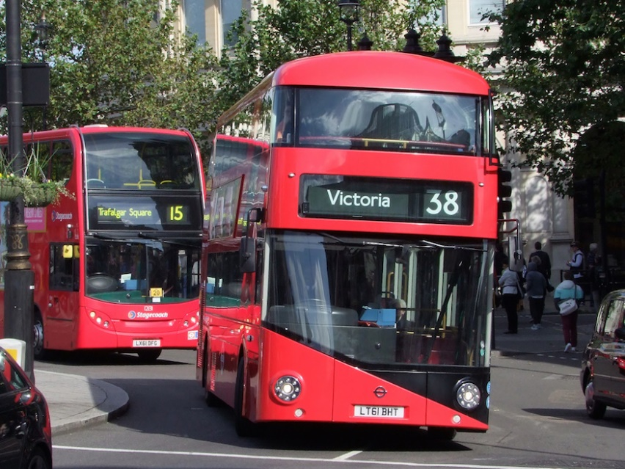
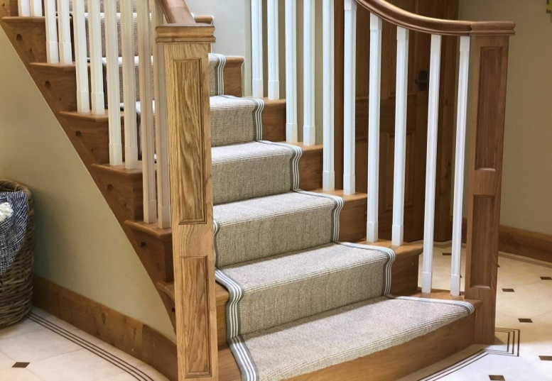
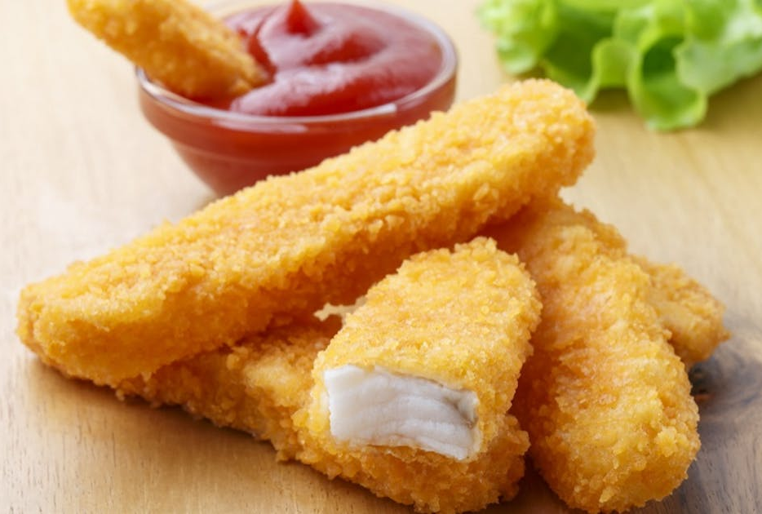
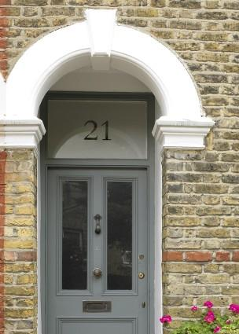
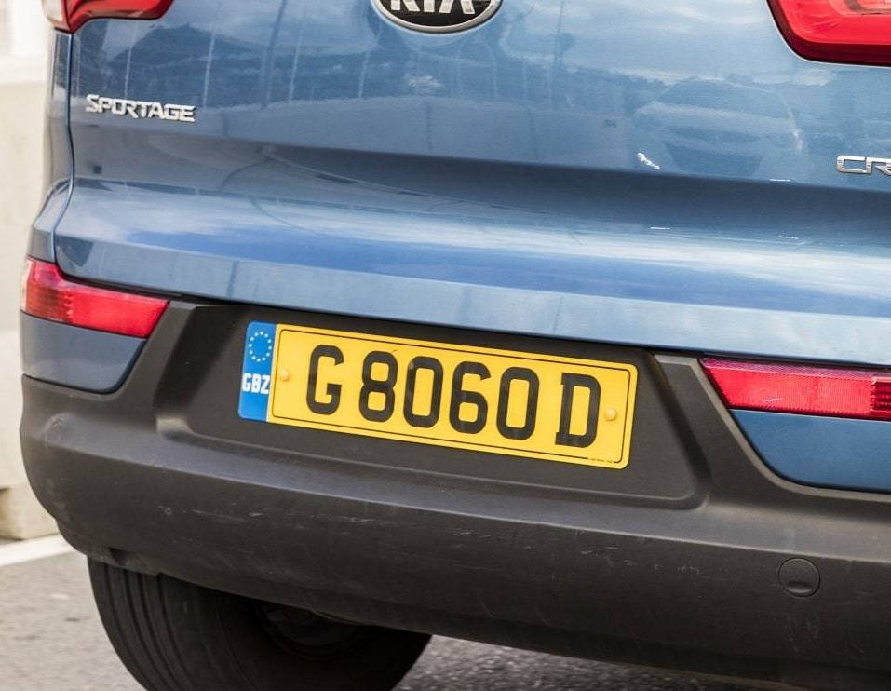

Maths is all around us!

Slide 17
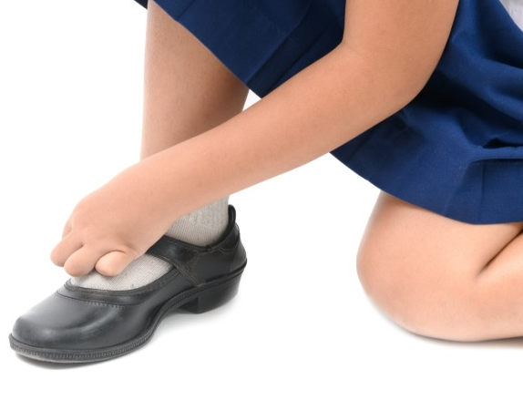


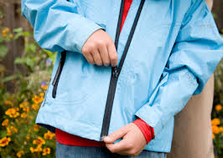
Personal Social & Emotional Development (PSED):
PSED supports children to make friends, build relationships, understand and talk about feelings, learn about ‘right’ and ‘wrong’ and develop independence.
At home:
Ask children how they are feeling and why.
Have open discussions.
Encourage them to ‘have a go’.

Slide 18
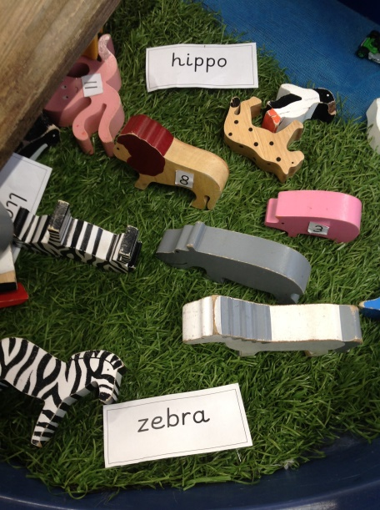
Communication & Language (CL):
Communication & Language is developed through:
language rich classrooms
whole class discussions
sharing stories
questioning
introducing new vocabulary
At home:
Talk with your child.
Ask questions (why)/challenge their thinking.
Open ended questions eg ‘Tell me more about…’
Allow children time to answer.

Slide 19
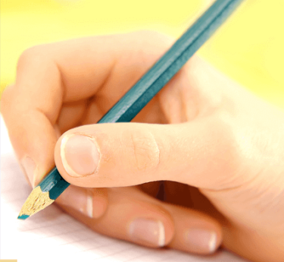
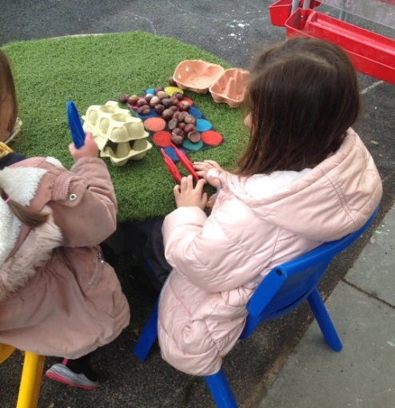
Physical Development (PD) – Fine & Gross Motor Skills:
Gross Motor: climbing, building with loose parts, digging, balancing, rolling and running.
Fine motor: tweezers, threading, playdough, Lego,
Cutting using scissors.
These are all easy to do indoors…and in the great outdoors!
At home, encourage your children to practise their writing by helping with a shopping list, or writing their name on their work.
Help your child with dressing, putting on and removing jumpers and shoes.

Slide 20
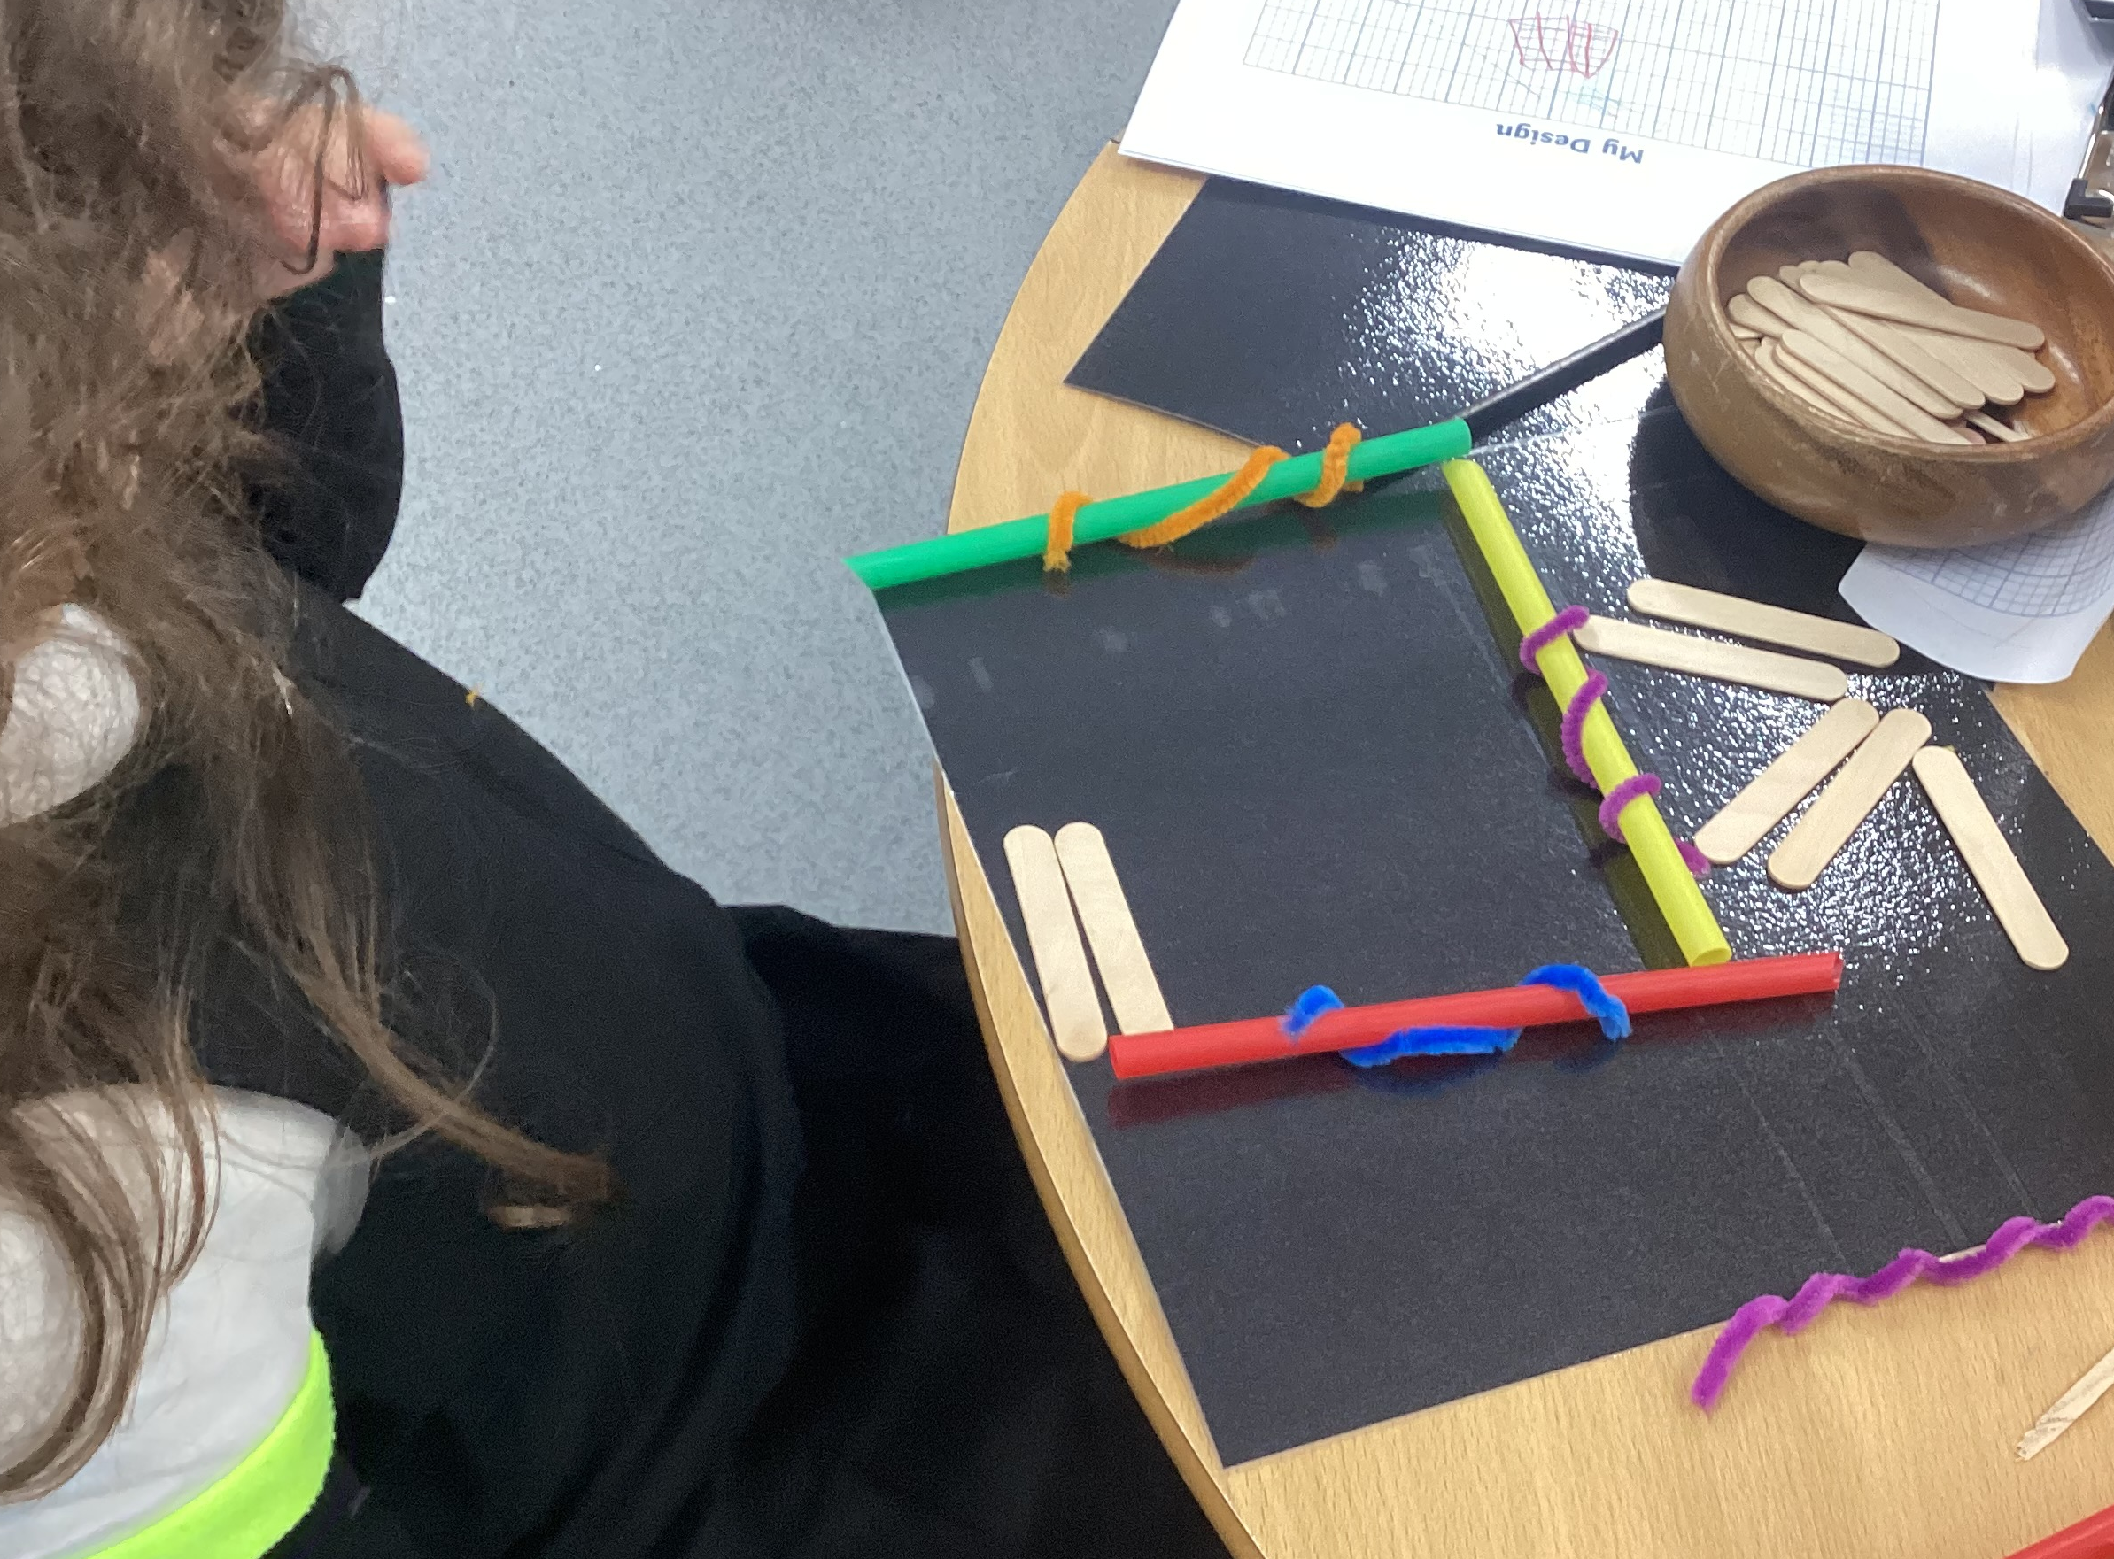
Understanding the world (UW):
Exploration
Investigation
Curiosity
At home:
Celebrating and discussing celebrations e.g. Diwali, Christmas, Lunar new year, Holi etc.
Discussing your roles (what you do as a job).
Talking about time (days of the week, months of the
year).

Slide 21
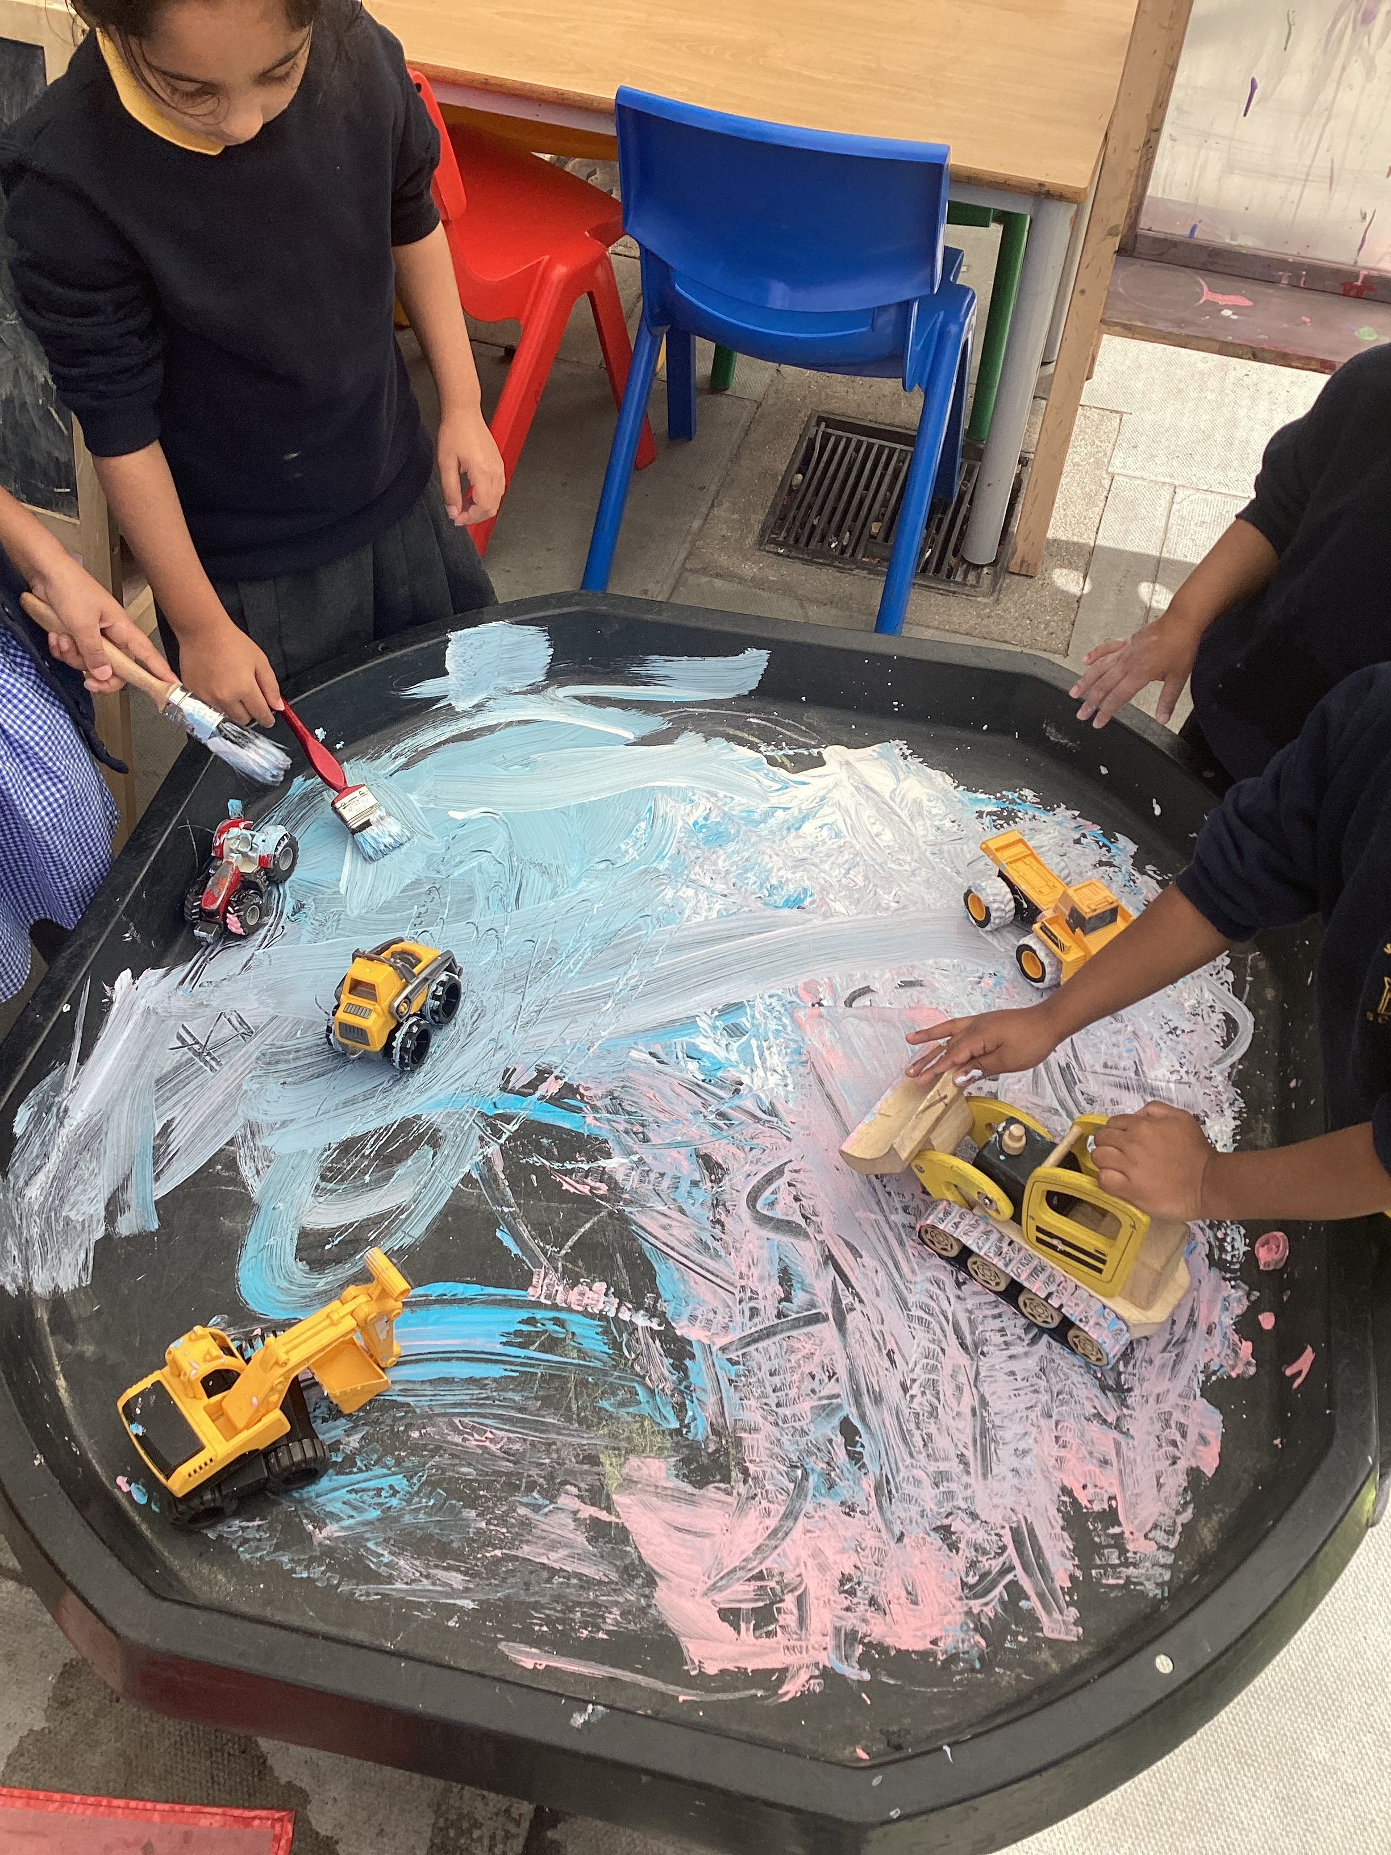
Expressive Arts & Design (EAD):
Expressive arts and design can be seen
through:
Pretend play.
Music – listening and exploring instruments.
Art – different materials, tools and
techniques.
At home:
Providing opportunities for art and design.
Encourage the mess! (just make sure they tidy up
afterwards).

Slide 22

Assessment in Reception
- a statutory requirement is to be completed and submitted at the end of the Reception year, this is known as achieving GLD
Children are assessed within the first 6 weeks of starting school, this is called the RECEPTION BASELINE and is conducted via the DFE portal.
The Baseline data is then used to direct and target interventions, focus groups and 1:1 learning within the Reception classrooms.
Assessment of the children's understanding, progression and knowledge is ongoing and continuous in order for all children to have the input they need to make progress and succeed.
Children are assessed against the 7 main areas of development across 17 separate sub areas within them.
Little Wandle phonics and maths assessments are also carried out with the children each term to monitor progression and identify gaps in knowledge.
All children progress at different paces and we hope to ensure all children make the progress needed in order to be ready for the next phase of their journey.

Slide 23
GLD Good Level of Development
- a statutory requirement to be completed and submitted at the end of the Reception year
Children will be assessed against the 7 main areas of development across 17 statements to ascertain if a child is in line with Age Related Attainment Expectations.
Children will be assessed as either ON TRACK or NOT ON TRACK, this judgement will then be used to support your child as they transition into year 1.
This data is submitted to the Local Authority and parents and carers will receive this information as part of the End of Year Report. Schools can be moderated to ensure that assessments and judgements are accurate.
These judgements help us direct resources in order to better support the children as they move through their educational journey. A child ‘not on track’ may need a little more support or develop a stronger confidence in a particular area in order to access the curriculum ahead. Throughout the year, we will keep parents and carers updated as to any observations throughout the year.
At Parents Consultations, we will share an update of how the children are achieving against the GLD.

Slide 24
Occupations week
A little reminder that should you have an occupation you are willing to share with the children, please let one of the Reception teachers know.
Class Reps

Slide 25
THANK YOU
Questions

