Slide 1

Welcome to
Sherington
Primary School
June 2026
Sherington Sings: Spring 2025

Slide 2
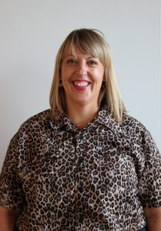

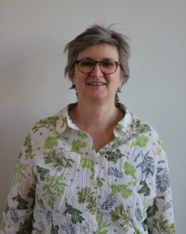
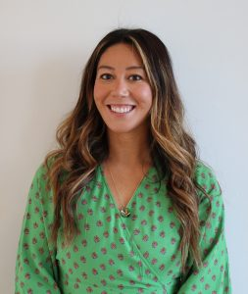
Meet the team...
Hannah Freeman – Headteacher and Designated Safeguarding Lead
Gary Hinchliffe – Deputy Headteacher and Deputy Designated Safeguarding Lead
Jo Richards – SENCo
Kim Peterson – Assistant Headteacher

Slide 3
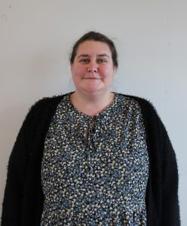

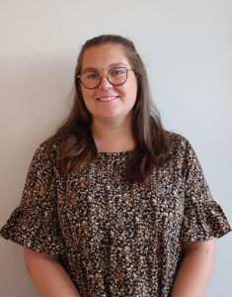

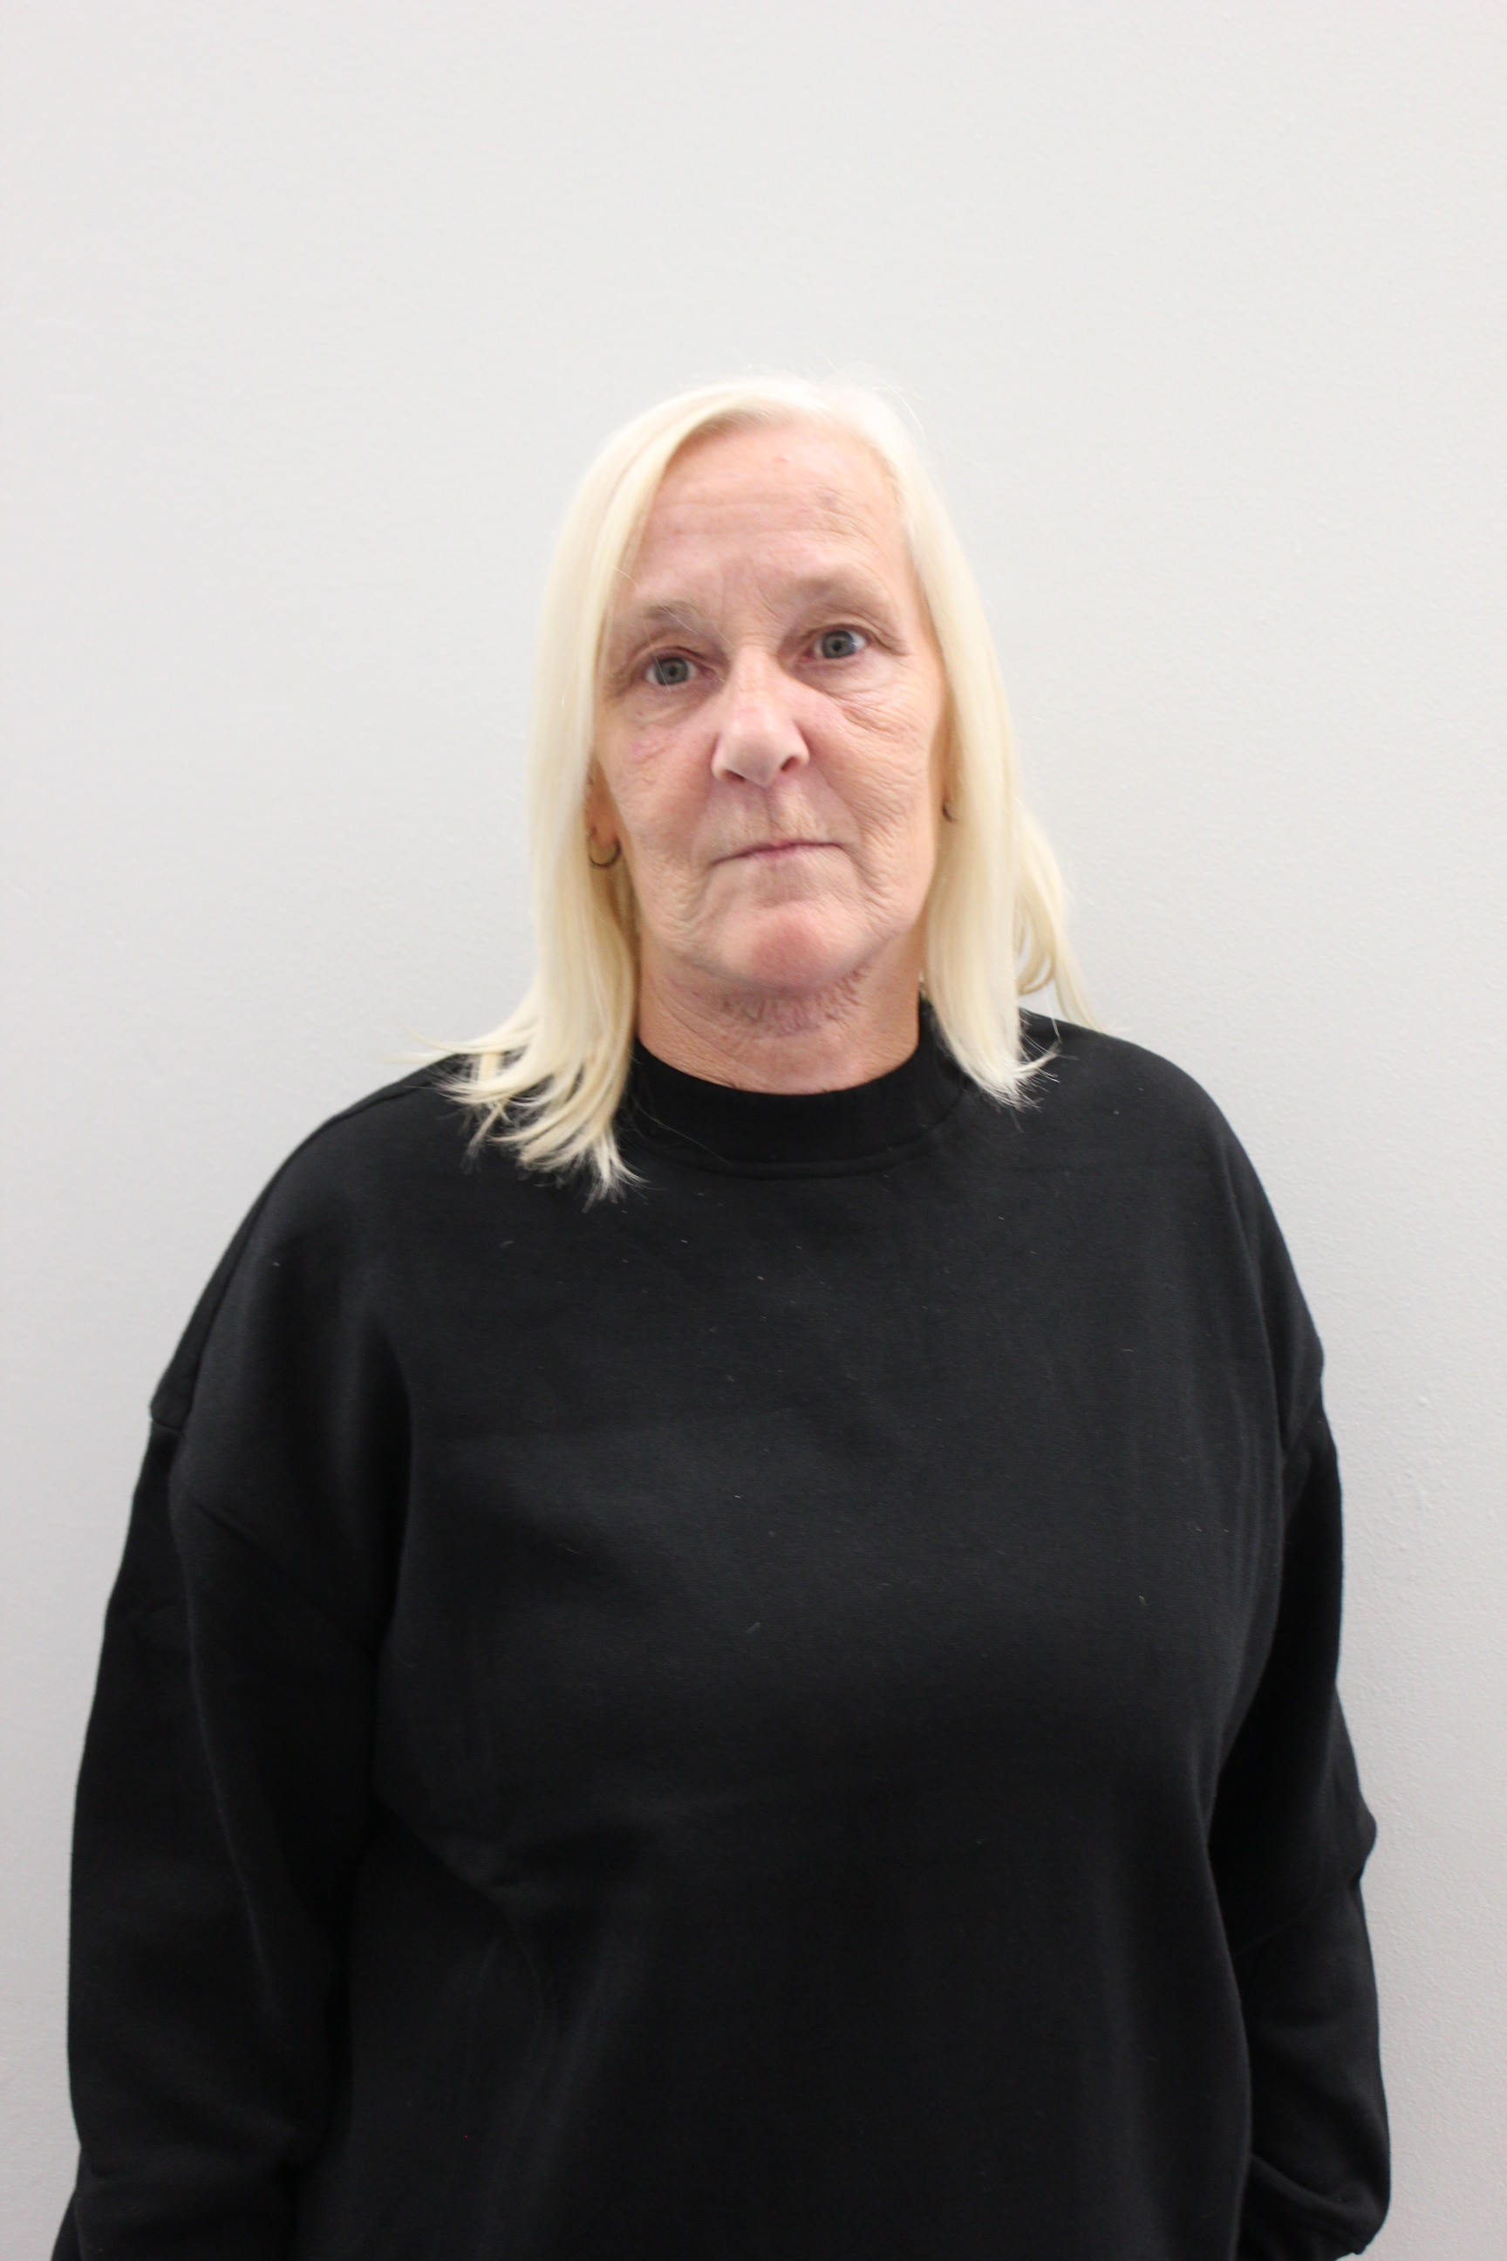
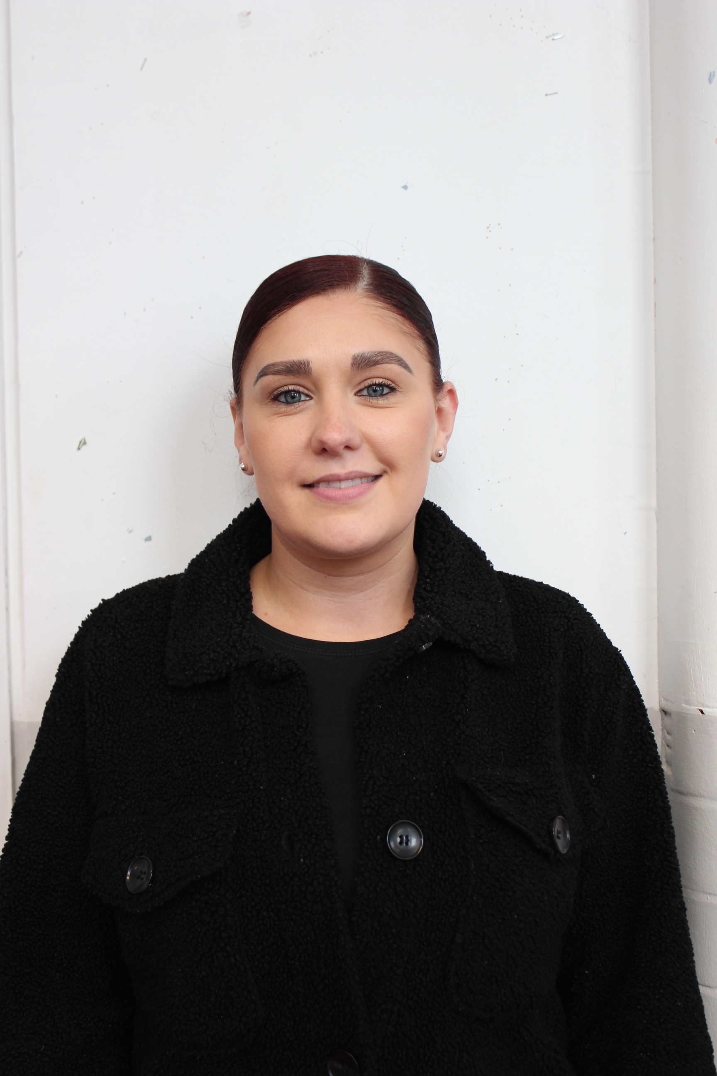
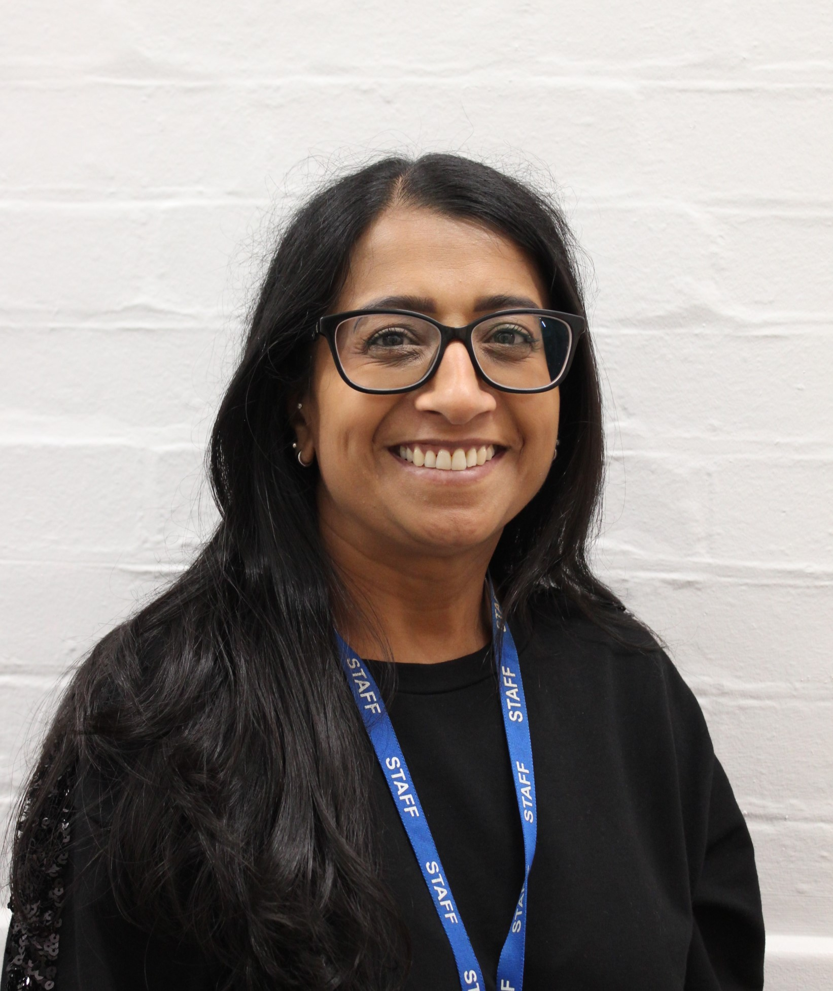
Meet the team...
Jo Hardy – Class Teacher
HIDA
Jolie Bull – Class Teacher
BLUE
Paula Townsend – Learning Support Assistant
Rachel Lewis – Learning Support Assistant
Gurjit Bahra – Learning Support Assistant (pm only)

Slide 4
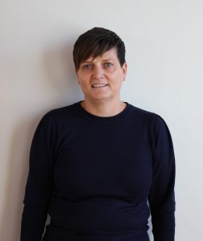
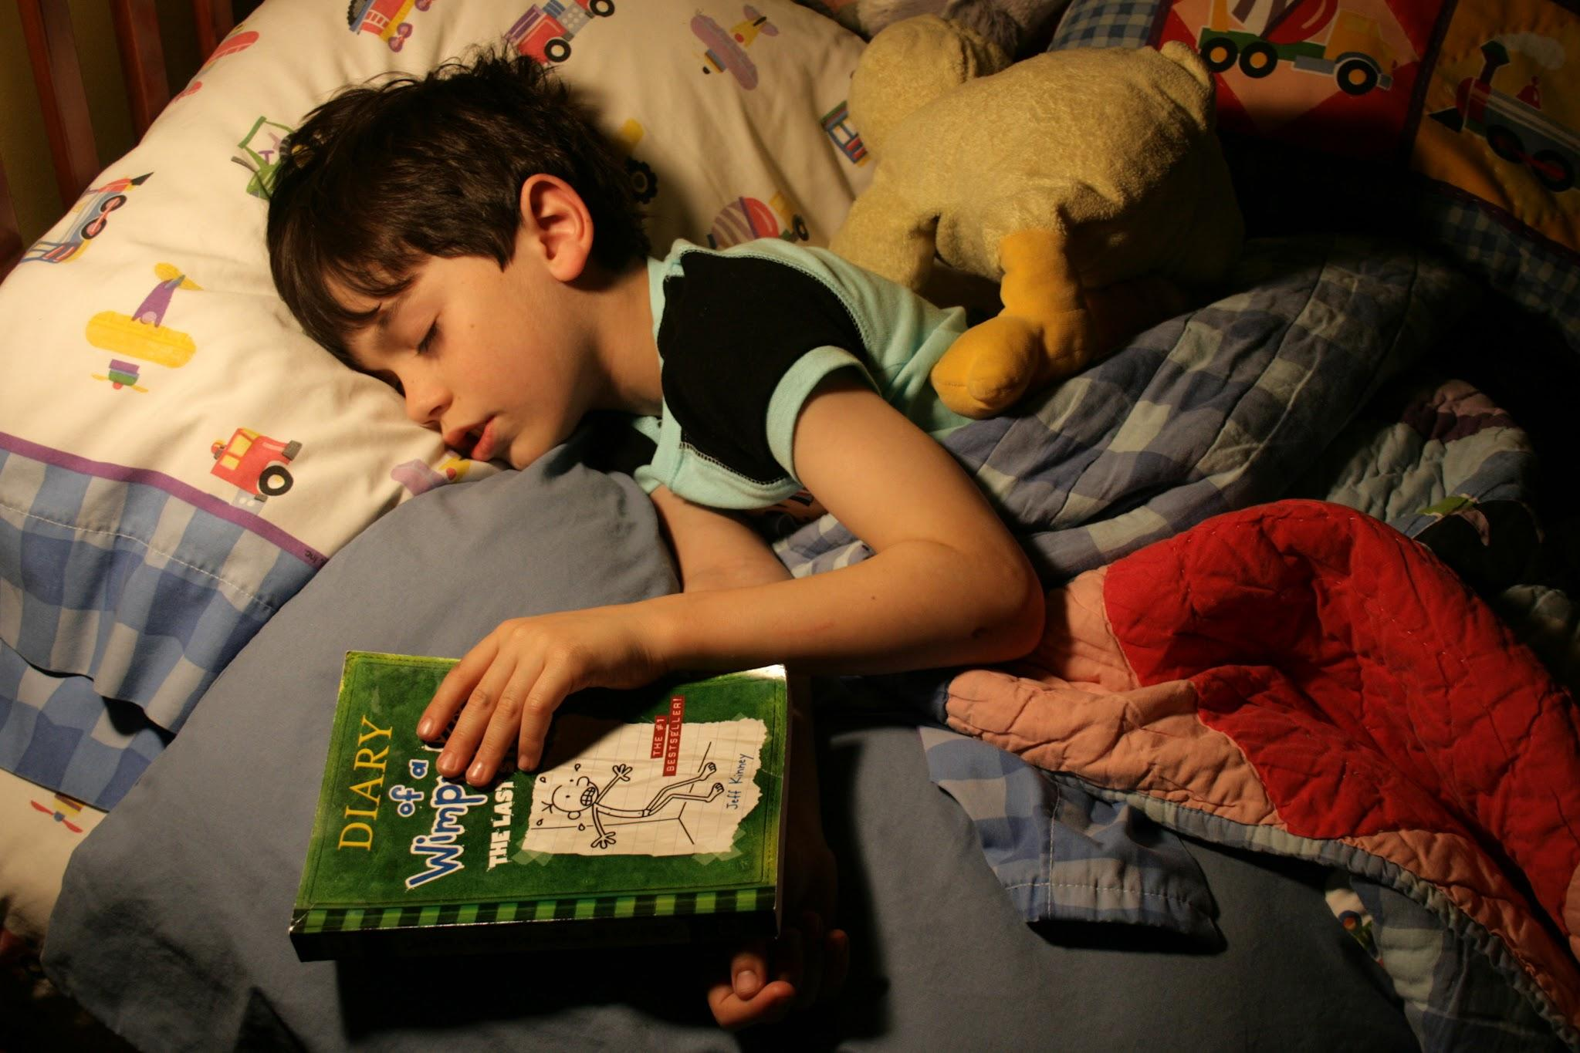


Meet the team...
Sarah Amis – Wellbeing Lead and Attendance Champion & Deputy Designated Safeguarding Lead

Slide 5
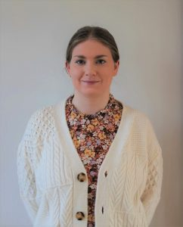
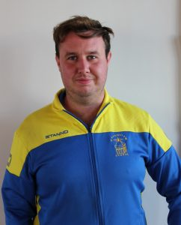
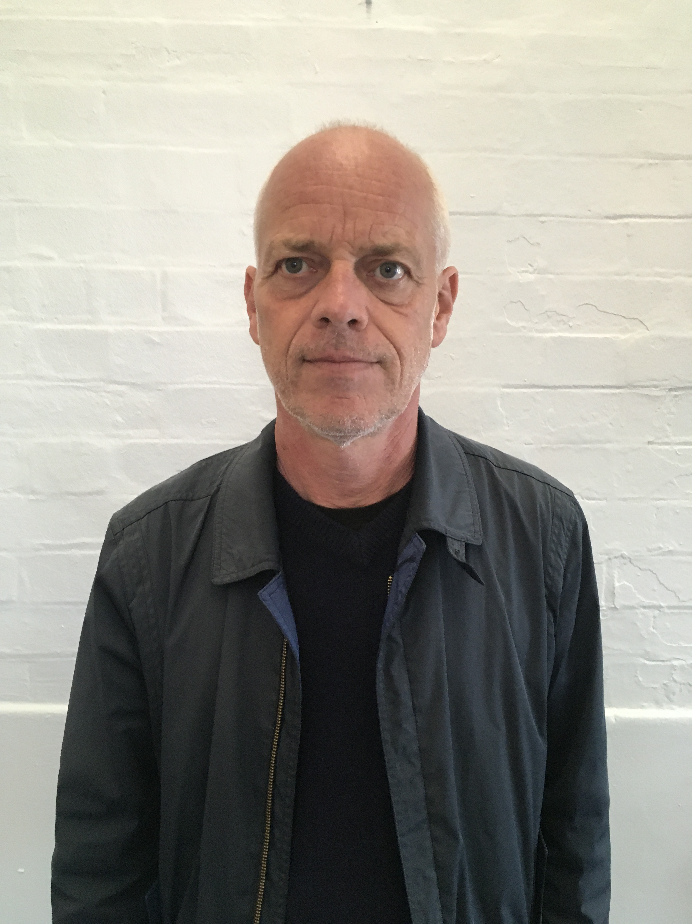
Meet the team...
Ms Gammon – Forest School
Mr Flynn – PE
Mr MacNamara – PPA

Slide 6
What information do I need to provide before my child can start?
GTKY Meetings – thank you!
Pack – Forms to return, useful information booklet, Book Bag, Class and Teacher (This PPT will be on our website)
Please return the coloured forms:
Admission Information (blue)
Consent form for school trips and other off-site activities (pink)
Home school agreement relating to physical chastisement (grey)
Ethnicity, nationality, language and religion (yellow)
Parent/Carer & Pupil Acceptable Use Agreement (orange)
GDPR (green)
+ Birth certificate and proof of home address (e.g. council tax statement)
Free School Meal/Pupil Premium application ***

Slide 7
When are the taster days?
Session 1 (Monday 29th June) 1.30-3.00pm
Parents are invited to gather in the Creation Station for refreshments during this session, SLT will be present and uniform will be available to view and purchase
Session 2 (Monday 6th July) 2.00-3.00pm
Parents and carers are invited to join their child for a starting school stay and play on our playground. Please bring a snack for your child. Squash and water will be provided. Due to allergies and medical requirements please do not bring any food to share.
***SUMMER FAIR THIS FRIDAY 3.30-5.30pm on the playgrounds!***

Slide 8
When does my child start school?
Individual start letters in your pack
Friday 4th September: staggered start times – 11.30am (via Office)
Monday 7th September: staggered start times – 11.30am (via Office)
Tuesday 8th September: 8.50-12.30pm (via classroom doors) (including lunch)
Wednesday 9th September: 8.50-3.25pm (Sherington Xtra after school
club starts)
*** If your child needs a different offer, we will speak to you individually***

Slide 9

What are the timings of the school day?
8.45am – Gates open
8.50am – Registration (doors open)
9.00am – Register closes
11.40am – Lunchtime
3.20pm – Gates open
3.25pm – End of the school day (doors open, collection from classroom doors)

Slide 10

What will my child learn?
7 areas of learning
GLD – Good Level of Development
Curriculum Newsletters
All About EYFS Workshop
Reading books – Thursday book change

Slide 11
Buzz Days and Trips

Slide 12
Outdoor Provision
Please make sure that children do not
play on the climbing frame or with set up
equipment in the mornings or after school.

Slide 13
What should my child wear?
The full uniform policy is on our website:
All children in Reception to Year 6 need to wear school uniform. Branding is optional, with generic
items readily available in the school’s colours:
Navy-blue sweatshirt/cardigan/jumper
White or navy-blue collared shirt
Yellow, navy-blue or white t-shirt/polo shirt
Navy-blue, grey or black trousers/skirts/pinafores
Practical footwear: shoes/boots/trainers (i.e. not open toes, strappy sandals or heels)
In summer months, in addition to the above, children can wear:
Navy-blue, grey or black shorts
Blue or yellow gingham summer dresses
PE
Navy-blue or black elasticated shorts
Plain navy-blue or black tracksuit bottoms and sweatshirt or hoodie (hoodies may only be worn for PE)
Plain white, yellow or navy-blue t-shirt, with trainers or plimsols for outdoor (barefeet for
indoor)
Forest School – wellies, old clothes with long sleeves and legs
No jewellery apart from stud earrings, long hair should be tied back.

Slide 14
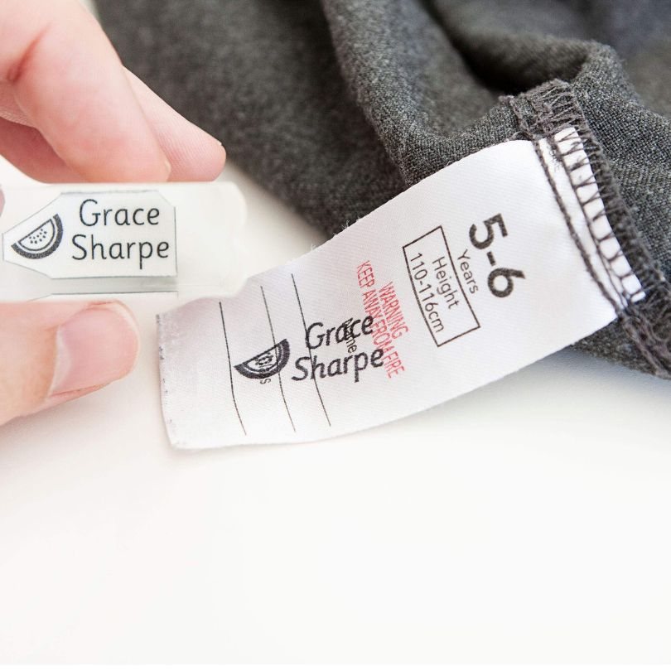
What will my child need to bring?
Appropriate outdoor wear – outdoor learning whatever the
weather!
Children will wear their PE kit to school so no need for a PE
bag
Book Bag – daily, books changed on Thursday
Water Bottle
Bag of spare clothes
EVERYTHING NAMED!!!!

Slide 15
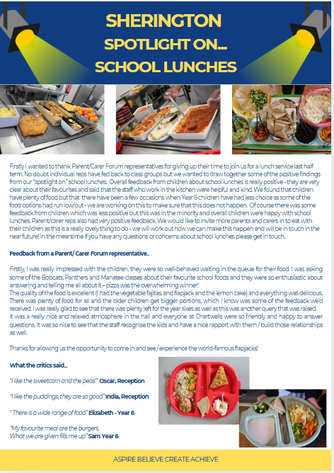

What will my child eat?
School dinners are highly recommended –
they are free for all children
Children will be supported in the dining hall until
they are more confident and independent
Packed lunches – healthy please! Water,
no sweets, no nuts and no sharing!
Lunch box choice!

Slide 16

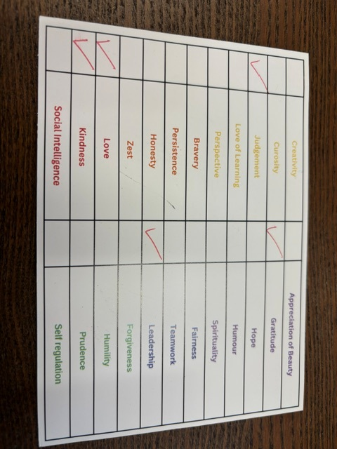
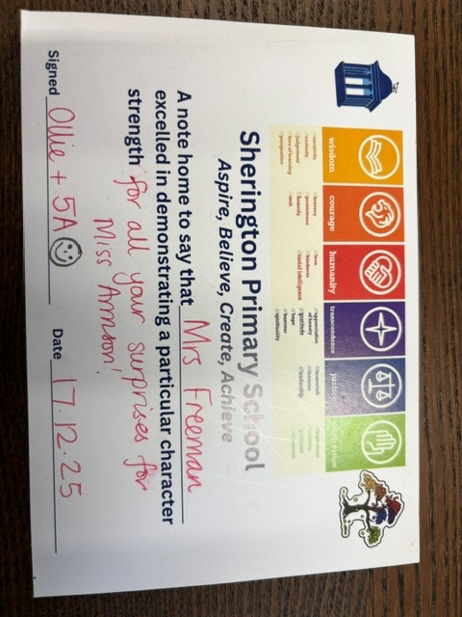
Behaviour for Learning at Sherington
Virtues and Character Strengths
Class Charter
Positive Praise, Wow Cloud, postcards and marbles
Recognition Assembly & The Bench of Glory!
HT Awards
Golden Tickets
Marble Jar
Reflection time, discussion with families, SLT

Slide 17


Sherington Xtra
Booking form on website
Activity clubs (start in Autumn 2 for YR)
Booked in advance
Invoiced half termly
REMEMBER TO ACCEPT YOUR OFFER!

Slide 18



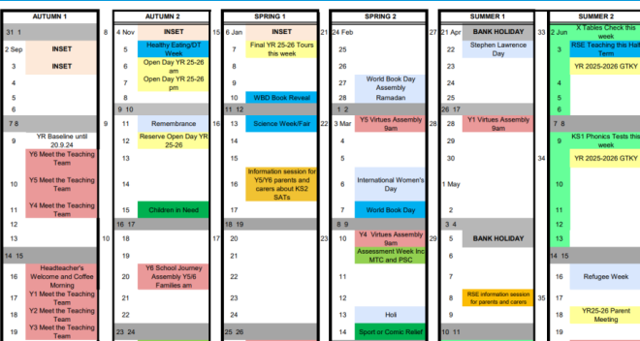
How will I communicate with school and vice versa??
Newsletters and Spotlight On
Calendar
Arbor App – turn on notifications!
Email
Parent Consultations (Oct, Feb, Annual Report)
End of day
Meeting request forms

Slide 19

What can I do to help prepare my child for school?
Be positive!
Talk
Read to them
Pincer and lean!
Independent toileting routines – boys trousers can be an issue!
Practice asking to go to the toilet
Practice getting dressed for school by themselves (fine motor!) including shoes – Velcro is best if they cannot tie laces
Lunch boxes
Teach them to lose
Don’t say “be brave”
Communicate with us – if there is something you are worried about, we are here to listen and to help
Getting children ready to start Reception
https://startingreception.co.uk/#the-basic-skills-to-practice

Slide 20
Things to be aware of but NOT worried about!
Tiredness
Day 2 blues!
Tears
The silent treatment
Not eating – very hungry after school!

Slide 21

Welcome to the Sherington Family!
Get involved…
FOS
Parent Forum
Reading Volunteers
Have your say
Governance

